Slide 1
Internal PPMs
Scrap + Repair Defects

Slide 2
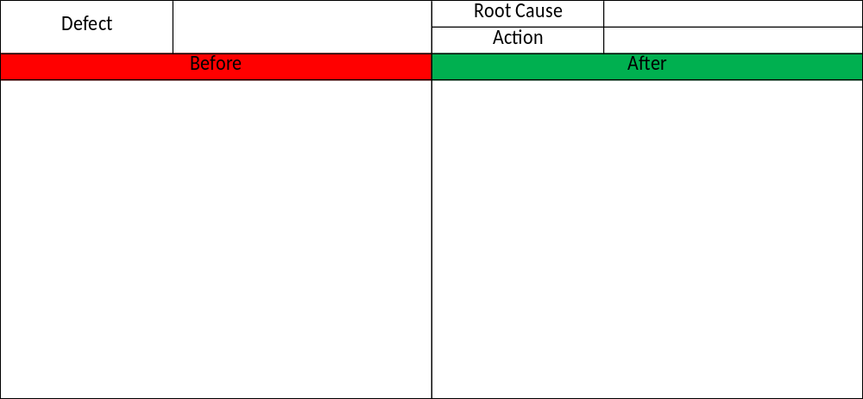
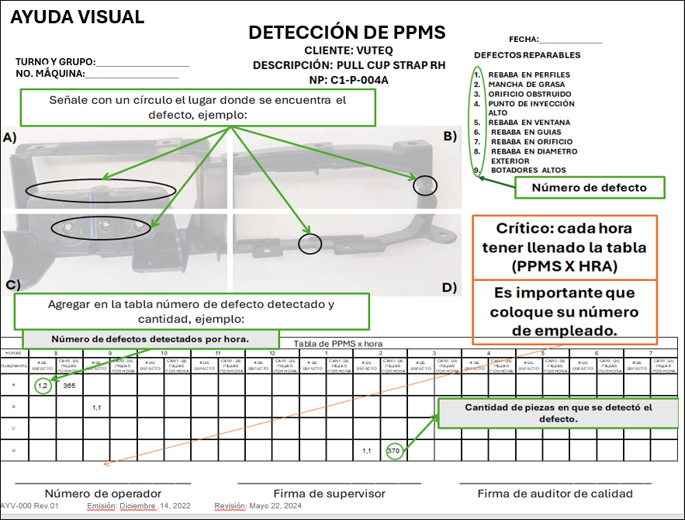
Process Defects
The plan is considerate Internal Defects all the Defects were repaired to do Actions
To Calculate PPMS Internal only considerated the Scrap Defects to do Actions
Report of 60 Days of Scrap
Defects with Rework or Reparation

Slide 3
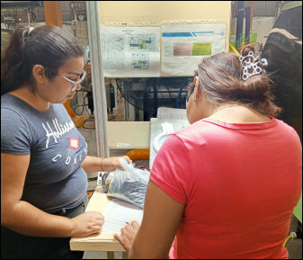
Pictograms by Part Number to Calculate Internal PPMs
Training of Implemantation

