Slide 1
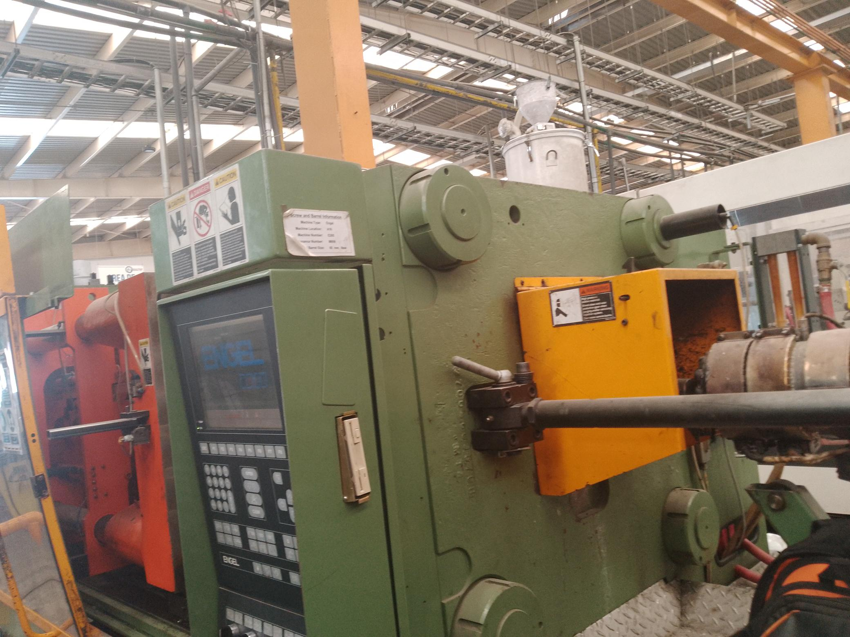
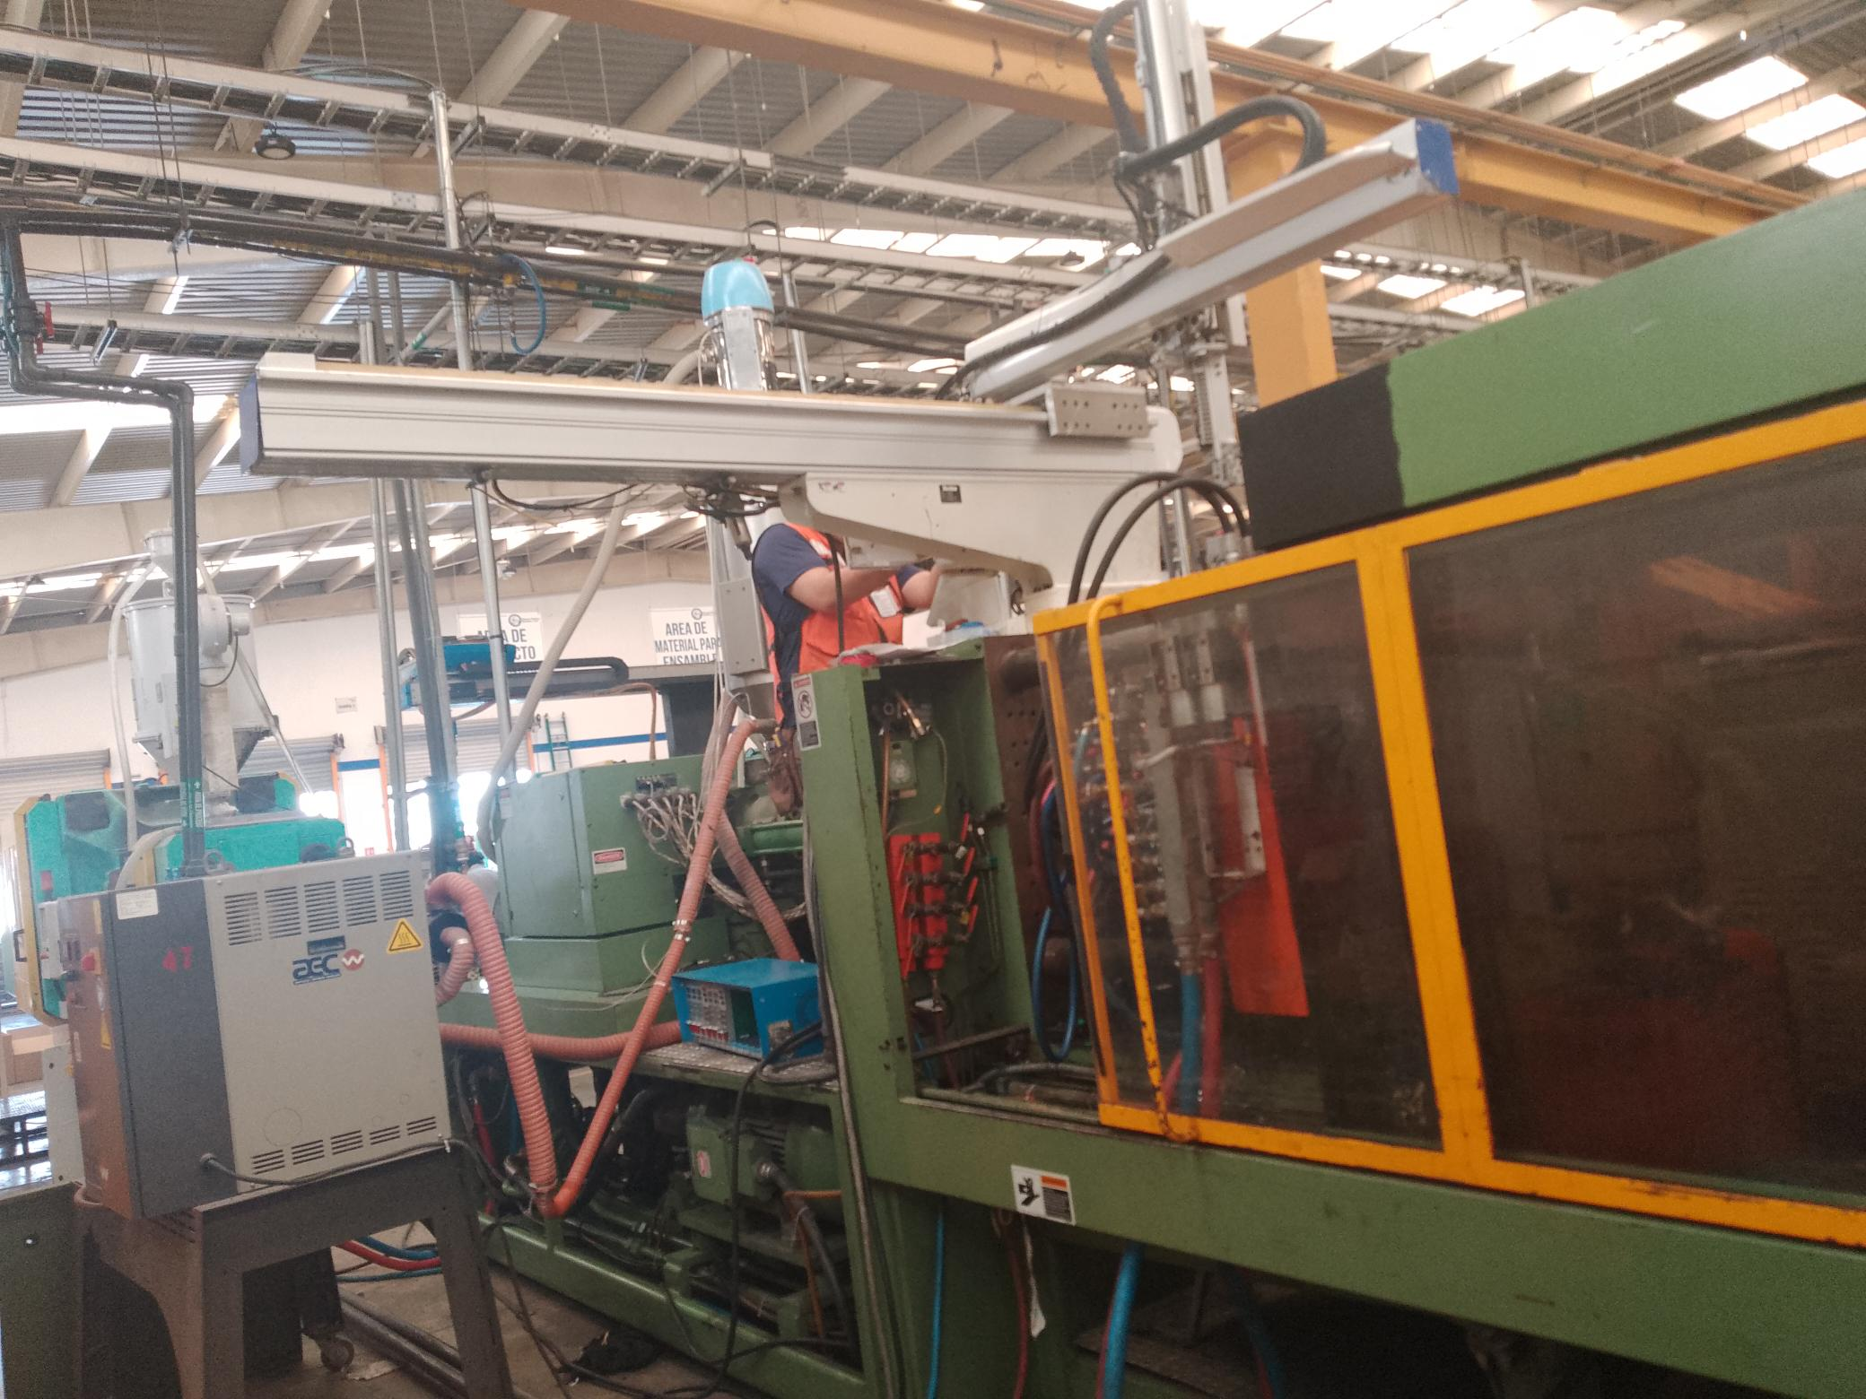
Implement Robot for Machine 47,
BEFORE
AFTER

