Slide 1
What’s A Kaizen?
Waste Elimination
January 2024

Slide 2
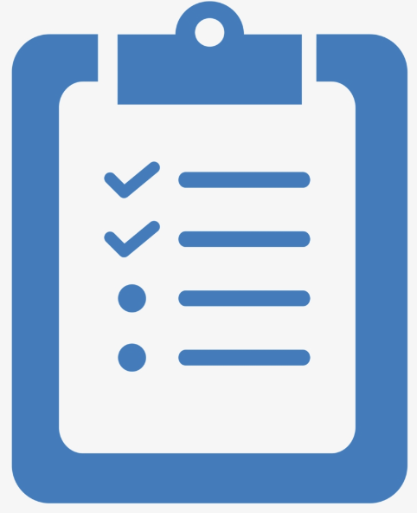
agenda
What is a Kaizen?
The Eight Forms of Waste
2024 Goals
Generating kaizen ideas
The Collection Process
Your Point Of Contact
For More Information

Slide 3
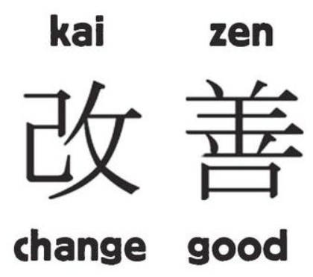
What is a kaizen?
Kaizen is an approach to creating continuous improvement through the elimination of waste.
The size and scope of a kaizen can vary. At Revere we define it as “a quick improvement that eliminates waste, and can be accomplished without major assistance from outside your natural work group”.
Next I will cover what are the eight forms of waste and give you examples of kaizen for each.

Slide 4
Eight forms of waste
DOWN TIME
Defects
Waste caused by the process’s inability to meet the customer’s expectations. It occurs in the form of scrap and rework.
Overproduction
Waste caused by not understanding customer demand. Creating more product than is needed.
Waiting
Waste caused by waiting for the next process step. Delays in the process that may cause idle parts or idle people.
Non-Utilized Talent
Waste caused by underutilizing talent, skills, and knowledge.
Transportation
Waste caused by the unnecessary movement of product or materials. Often caused by poor facility layout and planning
Inventory
Waste caused by excessive products and materials not being processed. Can result in increased storage cost and damage.
Motion
Waste caused by unnecessary of people (including the operator, team members, and the customer)
Extra Processing
Waste caused by “gold plating” or creating higher quality than is required.

Slide 5
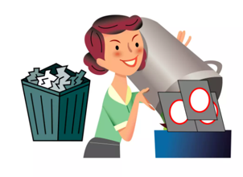
Eight forms of waste
Defects refers to defective or scrap materials. Defects increase the cost of inspection, and impacts customer satisfaction.
Examples of Kaizen that reduces or eliminates Defects
Repair a poorly maintained fixture reducing the scrap produced.
Poka-yoke the orientation of parts in a fixture to eliminate mistakes.
Adding of controls to eliminate missing screws.
Adding Visual Management to eliminate defects.
Reduce excessive handling of products reducing damage.

Slide 6
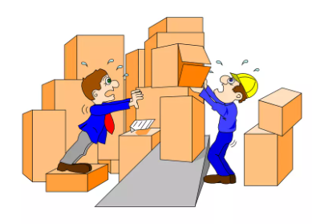
Eight forms of waste
Overproduction is supplying the process with more than is needed to meet requirements, sooner and faster than it is needed, causes almost all other types of waste. This is why overproduction is commonly called the worst type of waste.
Examples of Kaizen that reduces or eliminates Overproduction
Reduce the number of or frequency of meetings.
Reducing the generation and distribution of too much paperwork.
Do not produce products until their needed.
Do not produce more products than required.
Eliminating duplicate systems or redundant processes.
Reducing over-packaging.

Slide 7
Eight forms of waste
Waiting on machines to run or cycle, or machines waiting on operator. Waiting for parts, instructions, approval, information, maintenance, decisions…
Examples of Kaizen that reduces or eliminates Waiting
Install a manual station to continue production while waiting for a breakdown to be resolved.
Replace batching with one-piece flow.
Deliver material on a set schedule to work cells.
Install Kiosk in a work cell to eliminate waiting for information.
KanBan to eliminate waiting to be told which product is required next.

Slide 8
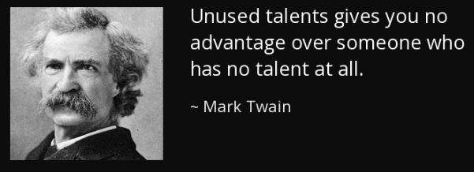
Eight forms of waste
Non-Utilized Talent occurs when team members are not seen as true process experts. People are told what to do, and asked not to think. Team members skills and abilities are not recognized or utilized.
Examples of Kaizen that reduces or eliminates Non-Utilized Talent
Eliminate wasteful or unneeded administration tasks.
Creating a training matrix.
Completing skill assessments.
Reducing the number of people required to approve something.
Increasing the number of people who can approve something.

Slide 9
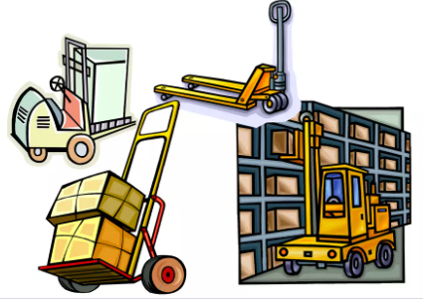
Eight forms of waste
Transportation is the double or triple handling, moving, in and out of storage areas and warehouses. Material can get damaged if it’s moved too much. It adds no value and is often used to get the extra inventory out of the way.
Examples of Kaizen that reduces or eliminates Transportation
Eliminating transportation of components from one work cell to another.
Eliminate the use of material handling devices to move batches of material from one machine to another within a work cell.
Stop sending unused parts from the assembly line back to the warehouse.

Slide 10
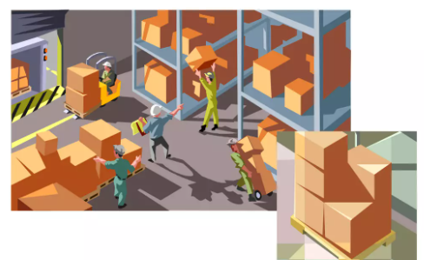
Eight forms of waste
Inventory requires people, equipment and space to count, transport, store, and maintain. If we do not get orders the material will become obsolete, and be thrown away. Inventory can mask other forms of waste.
Examples of Kaizen that reduces or eliminates Inventory
Reduction in raw materials.
Reduction in unsold finished goods.
Eliminating unserviceable molds.
Reducing the amount of MRO items.
Eliminating unused information from share points and folders.
Reducing excess supplies, including office supplies.

Slide 11
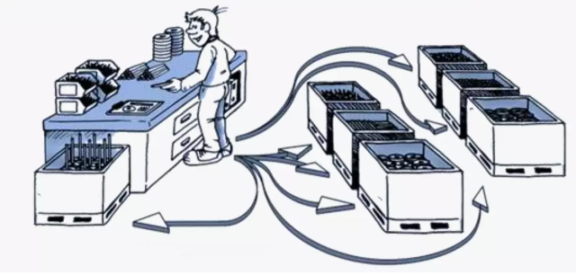
Eight forms of waste
Motion Walking without working (away from work station). Searching for tools, materials, or information. Reaching, bending or unnecessary motion due to poor housekeeping or workplace layout. Process is not designed with employee in mind.
Examples of Kaizen that reduces or eliminates Motion
Placing material, parts, tools and equipment within reach.
Eliminate walking across your work space.
Reducing turning and moving product during assembly.
Eliminate clicking through a series of folders on a computer.
Adding drop down lists to electronic forms.

Slide 12
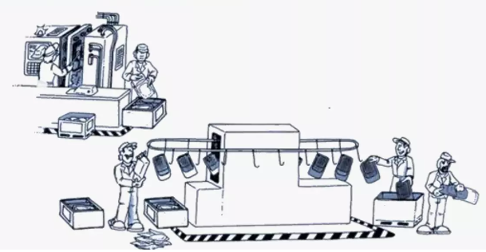
Eight forms of waste
Extra-Processing is doing more than is necessary to produce an effectively functioning product. Extra setup steps, over-specification of the process, extra processing steps.
Examples of Kaizen that reduces or eliminates Extra-Processing
Reducing the number of approvals required before work can progress.
Eliminating unproductive meetings, or the presence of unnecessary team members at meetings.
Eliminating unnecessary features that the customer does not use.
Eliminate processes that are not required by the customer.
Reducing excess paperwork or data entry.
Eliminating duplicate reports for the same process.

Slide 13
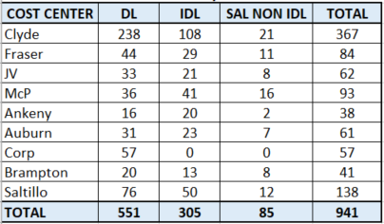
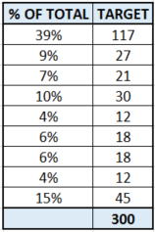
2024 goals
Goal By Month by Site
2024 Monthly Kaizen Goal Calculation by Site
The company goal is >300 per month starting in October which will result in over 2000 kaizens completed this year.

Slide 14
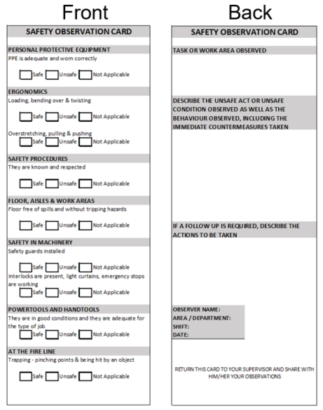
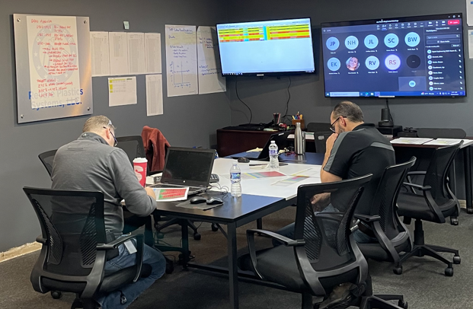
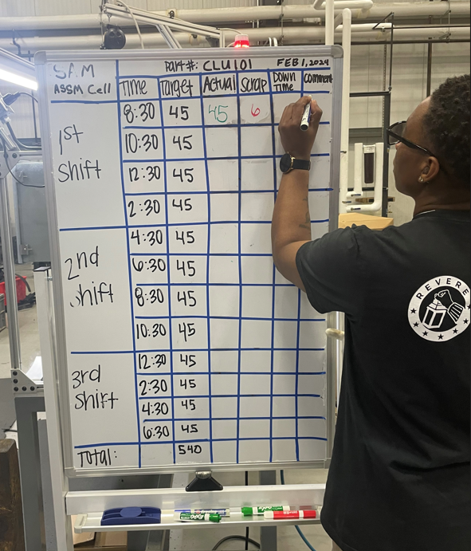
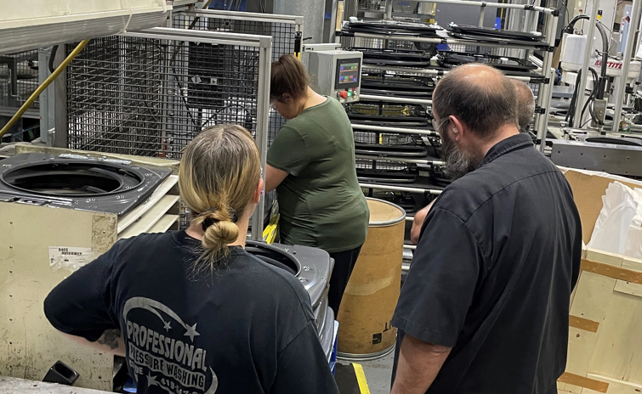
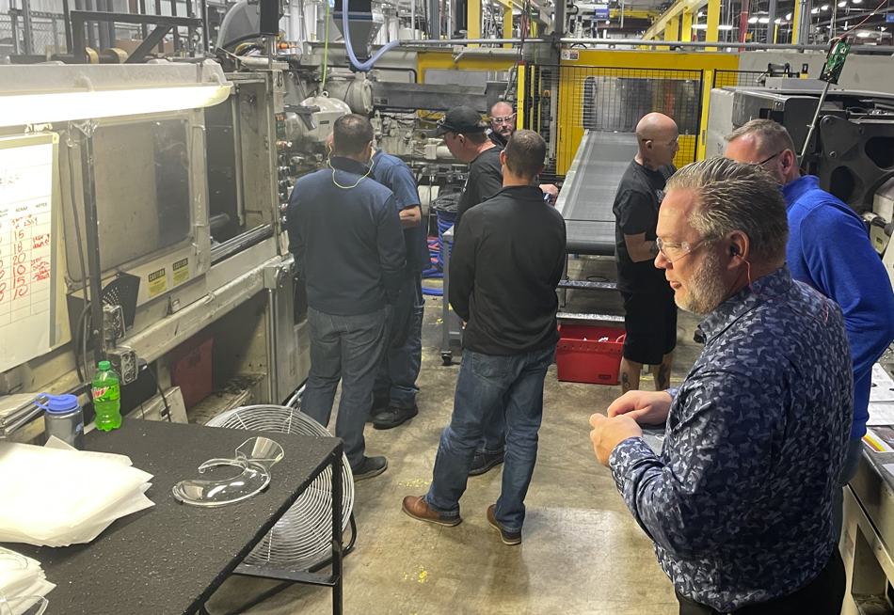
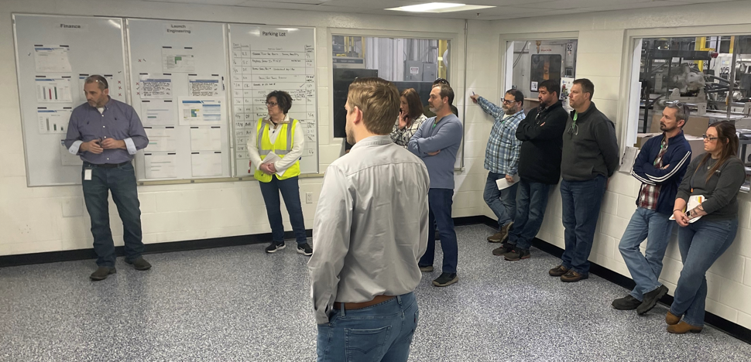
Generating kaizen ideas
There are so many sources for identifying kaizen opportunities.
Unsafe Acts & Conditions
Meetings
Hour by Hour Production Boards
Observations
Gemba Walks
War Room
Rapid Improvement Events (RIE)

Slide 15
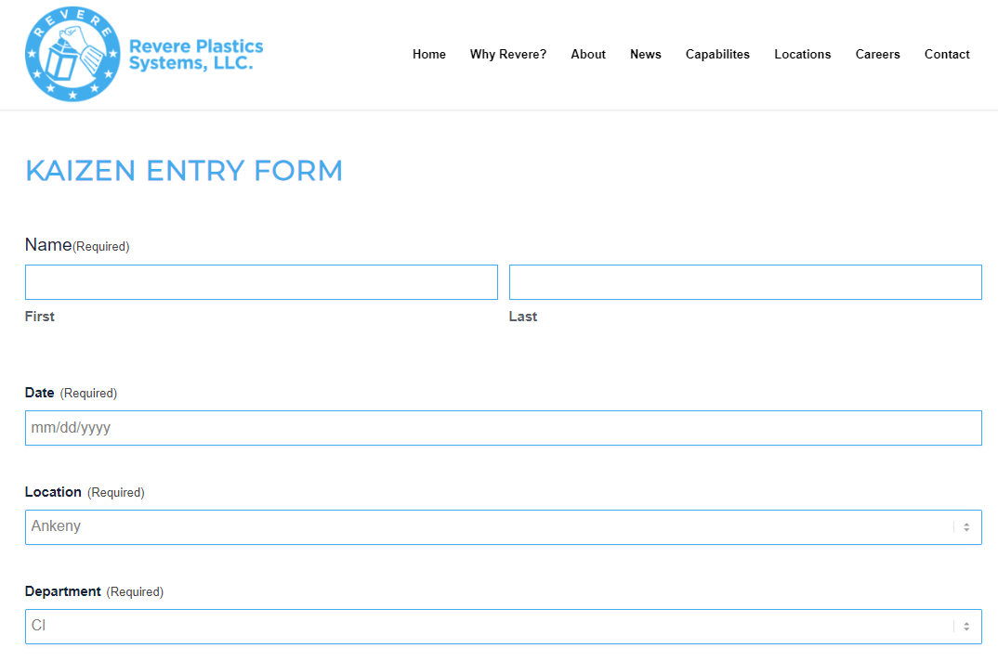
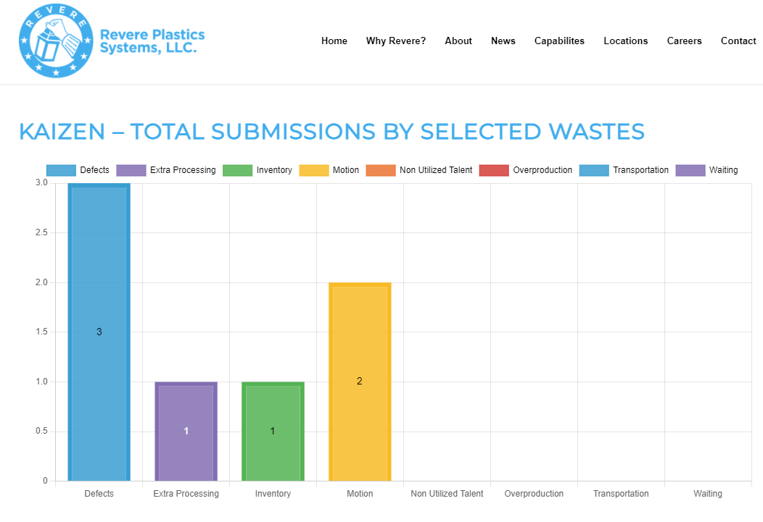
The collection process
To fill out the form go to https://www.revereplasticssystems.com/kaizen/, or you can click on the “Kaizen Entry Form” below (must be in slideshow for link to work).
When you click the “Submit” button at the bottom of the form it will auto update the charts shown below.

Slide 16
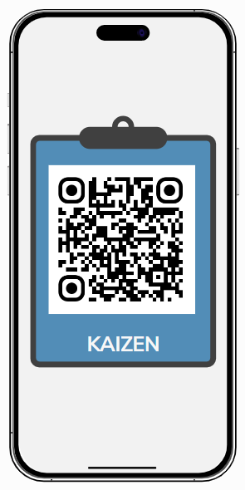
Kaizen collection point
Have a kaizen to document?
Click on the QR code to go to the Kaizen page and fill out the form.
Remember to take a before and after picture of your kaizen.
Or go to https://www.revereplasticssystems.com/kaizen/
Please post several copies of this slide in your facility

