Slide 1
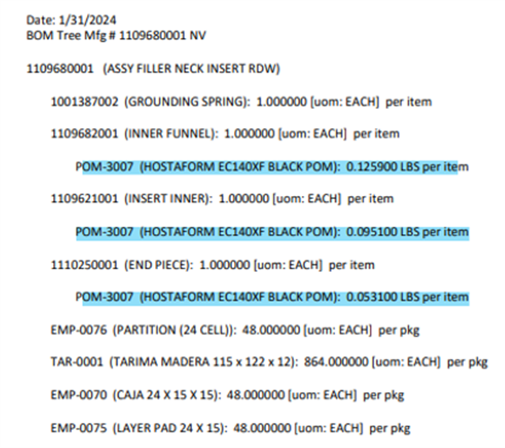
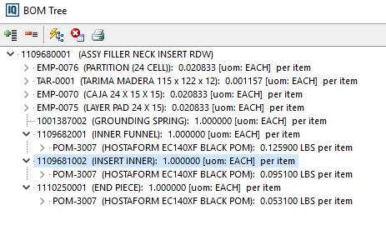
BEFORE
AFTER

Slide 2
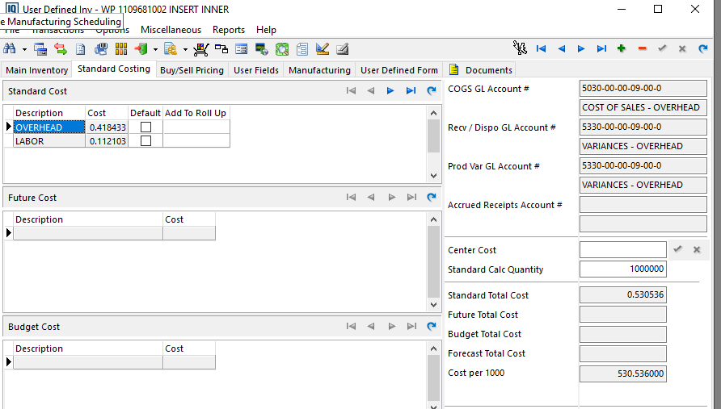
COST BY 1000 PIECES

Slide 3

LESSON LEARNED

