Slide 1
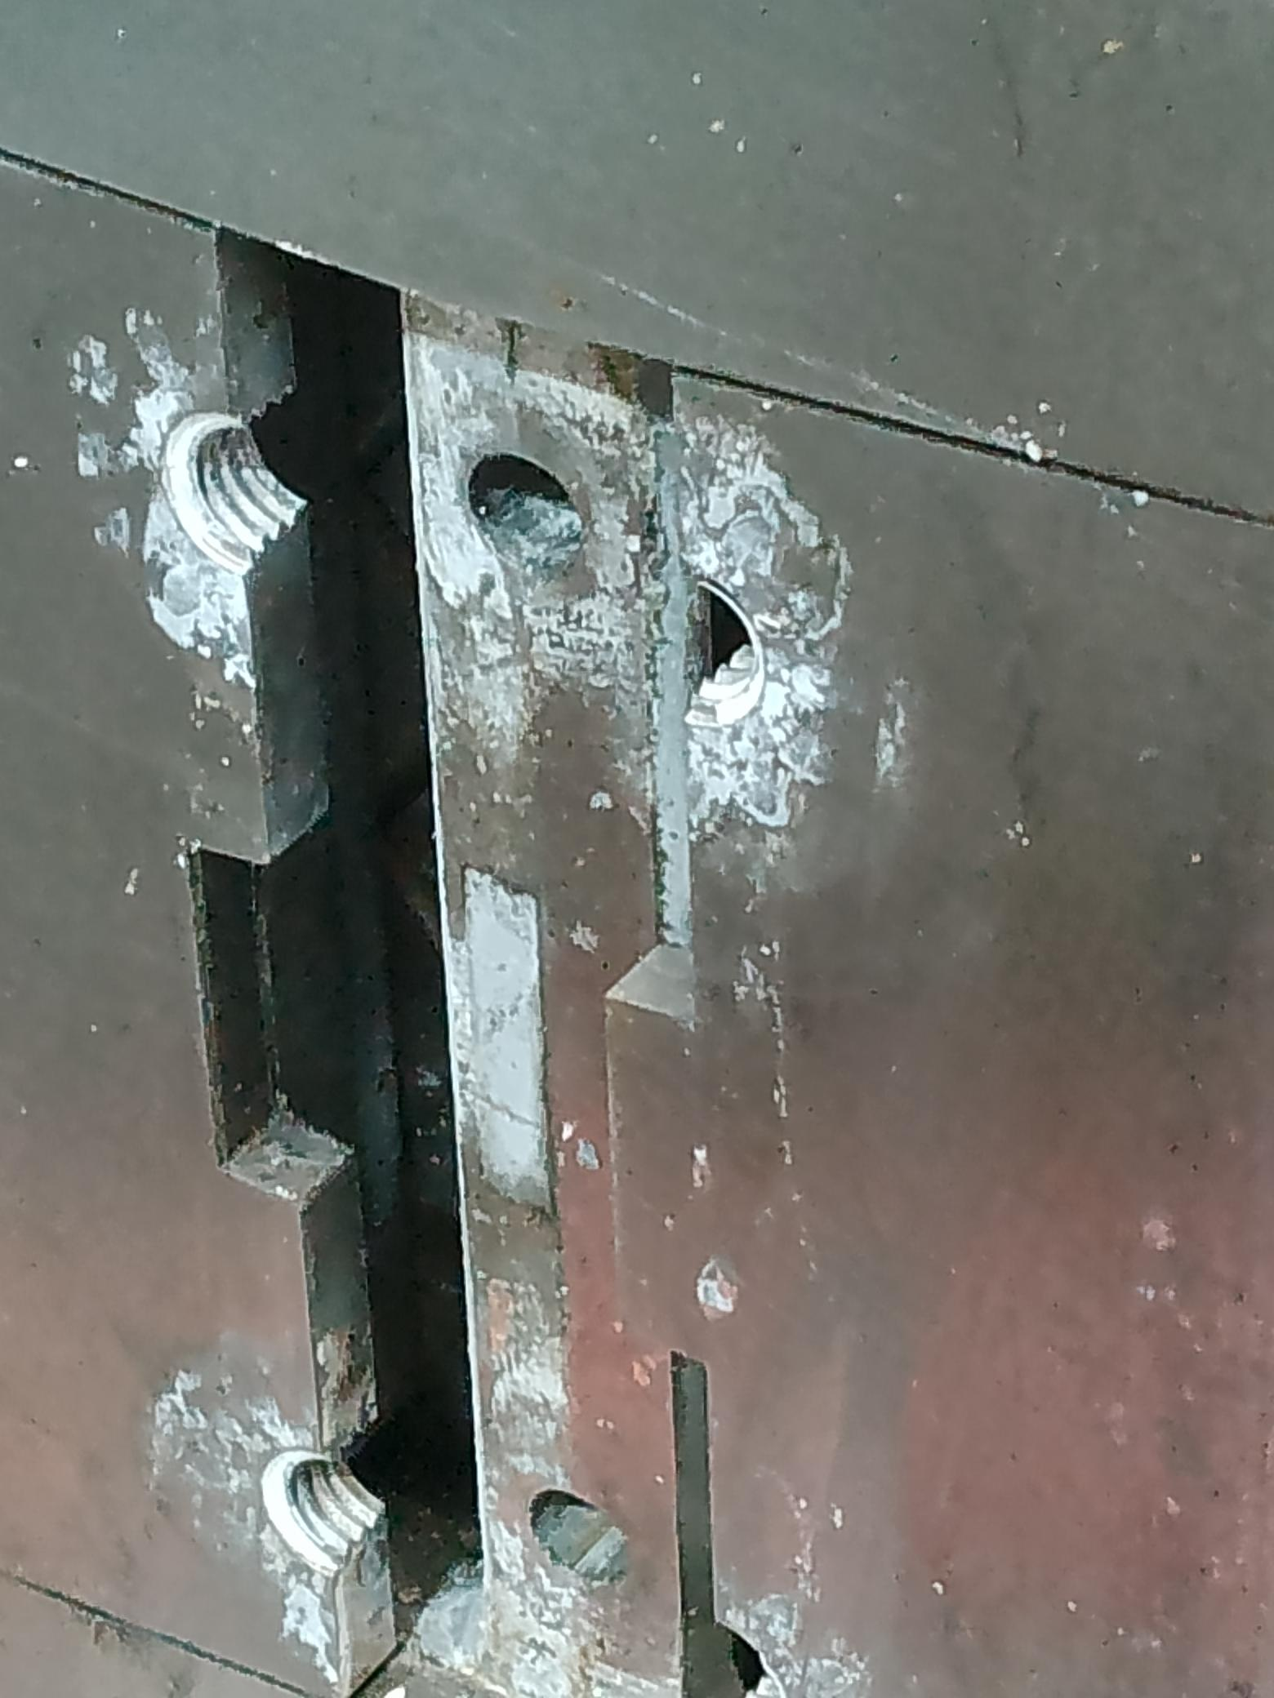
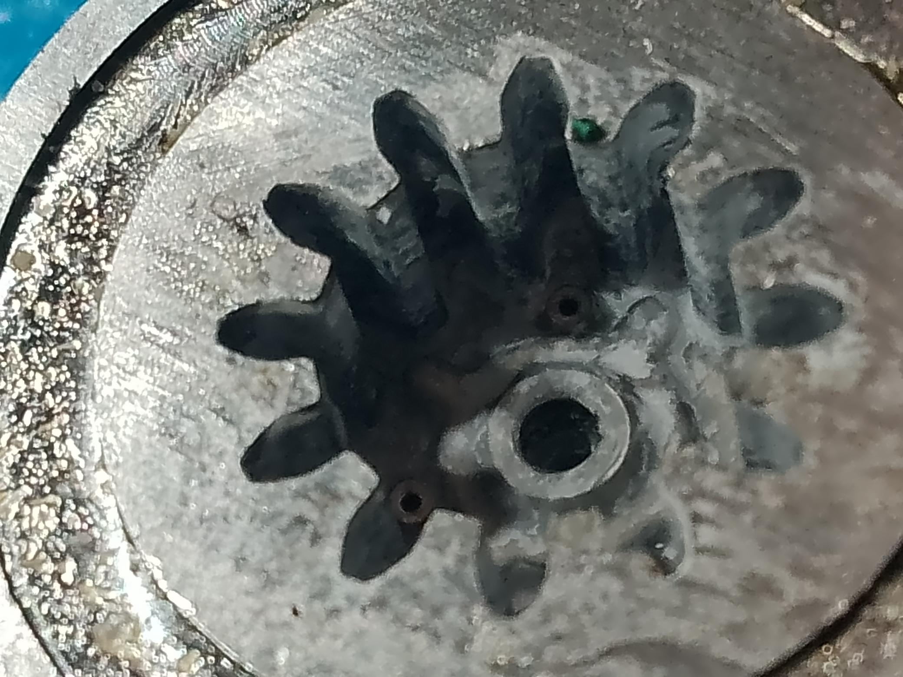
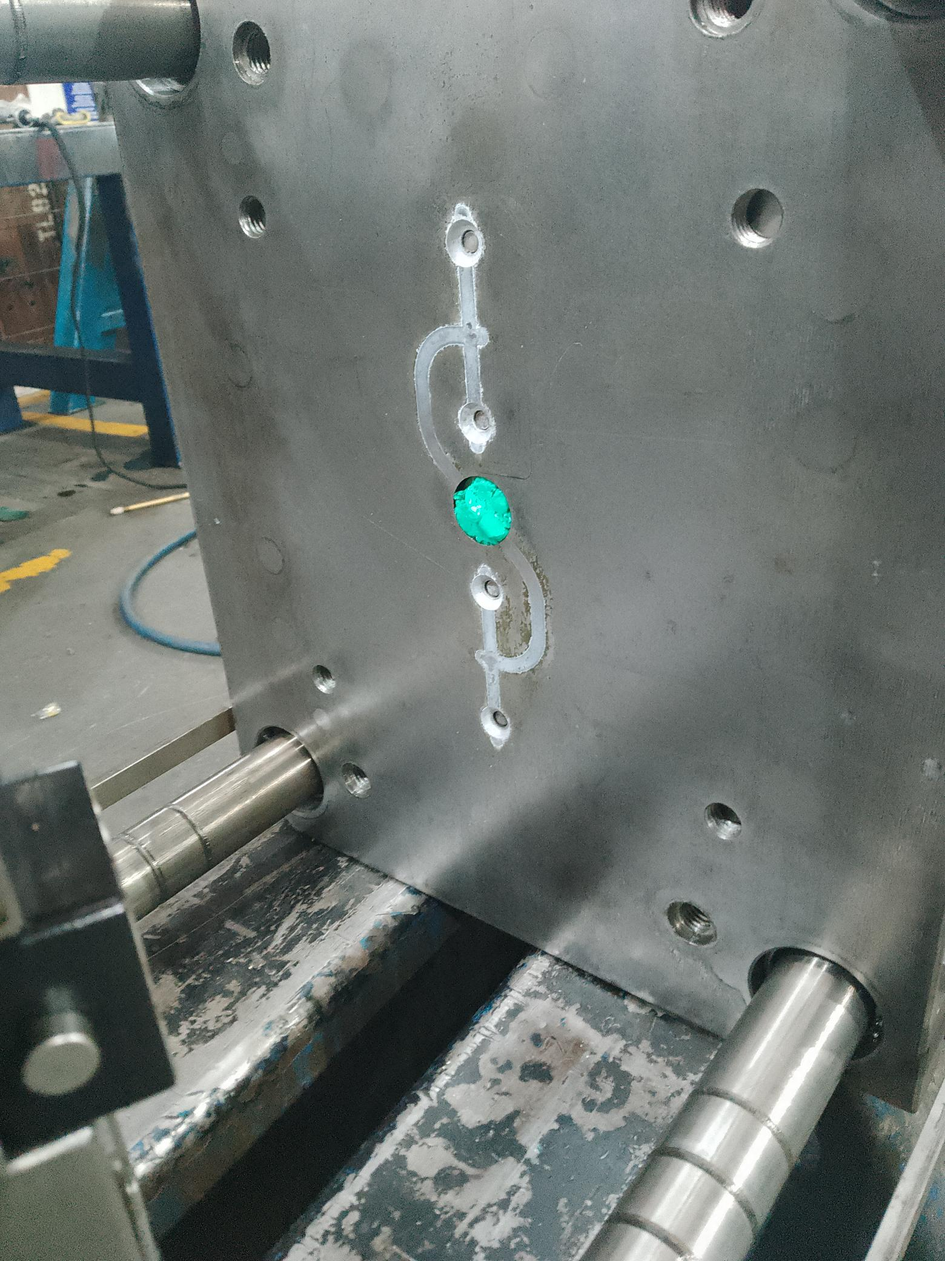
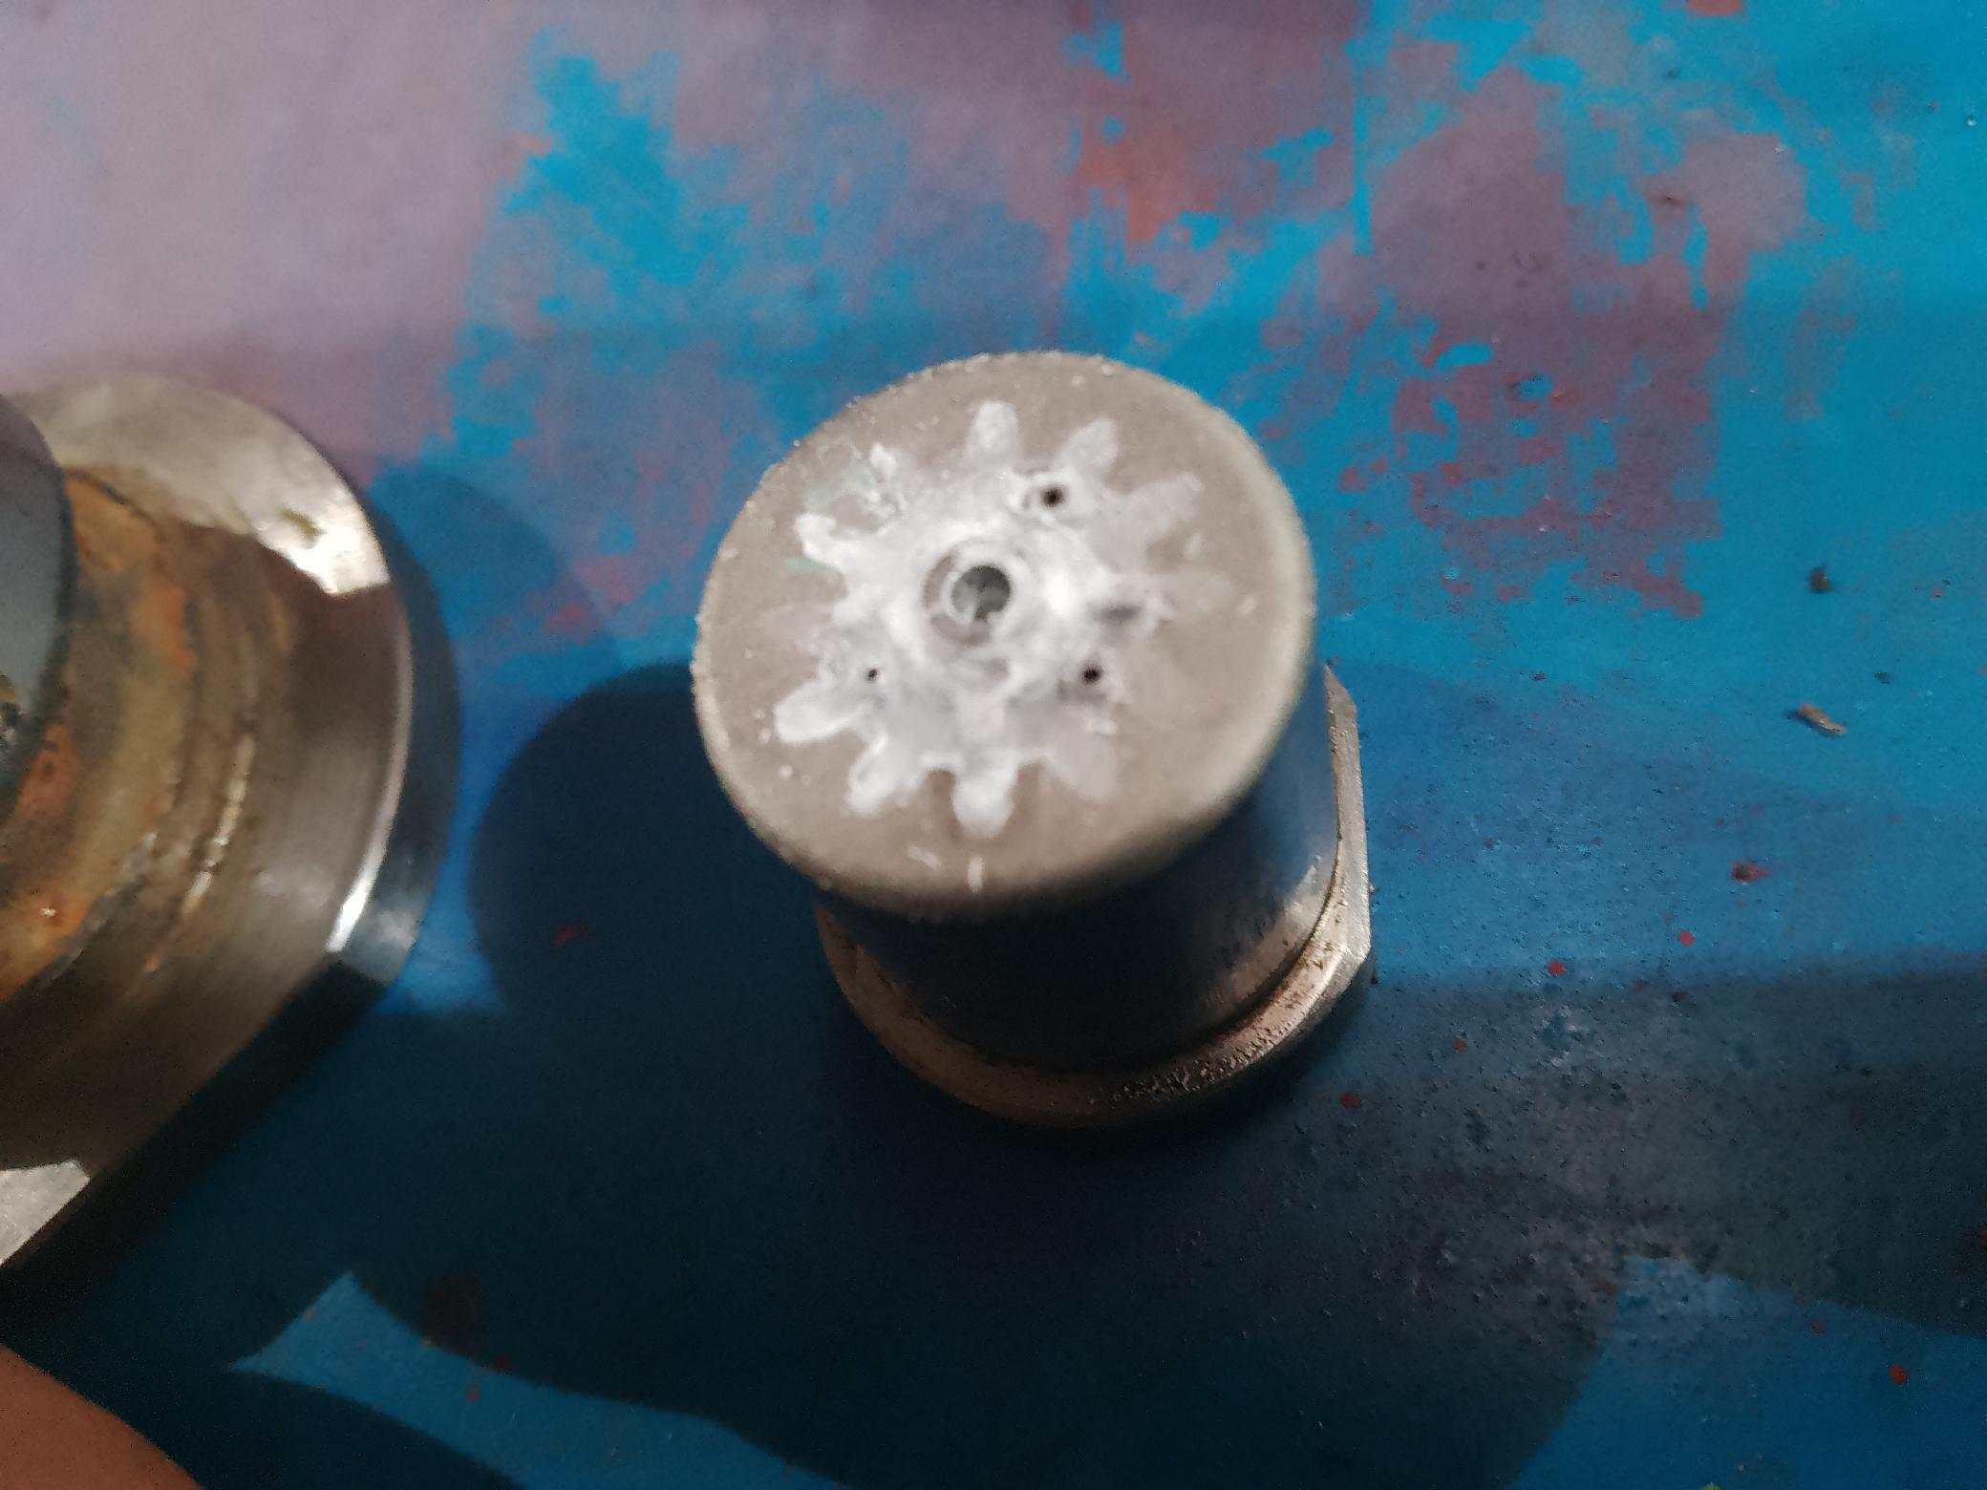
Molde H-BMQ 8095 P/N 43049F012
Problem: Mold reported with the Ejector plate stuck, this is the third time reported with the same problem, this cause 8 hours loss with no production. The mold is clean up, every time but run only few hours.
Solution: The mold needs to implemented vents.
GAS ACCUMULATED
R.Mtz. @ Jul 13, 2023

Slide 2
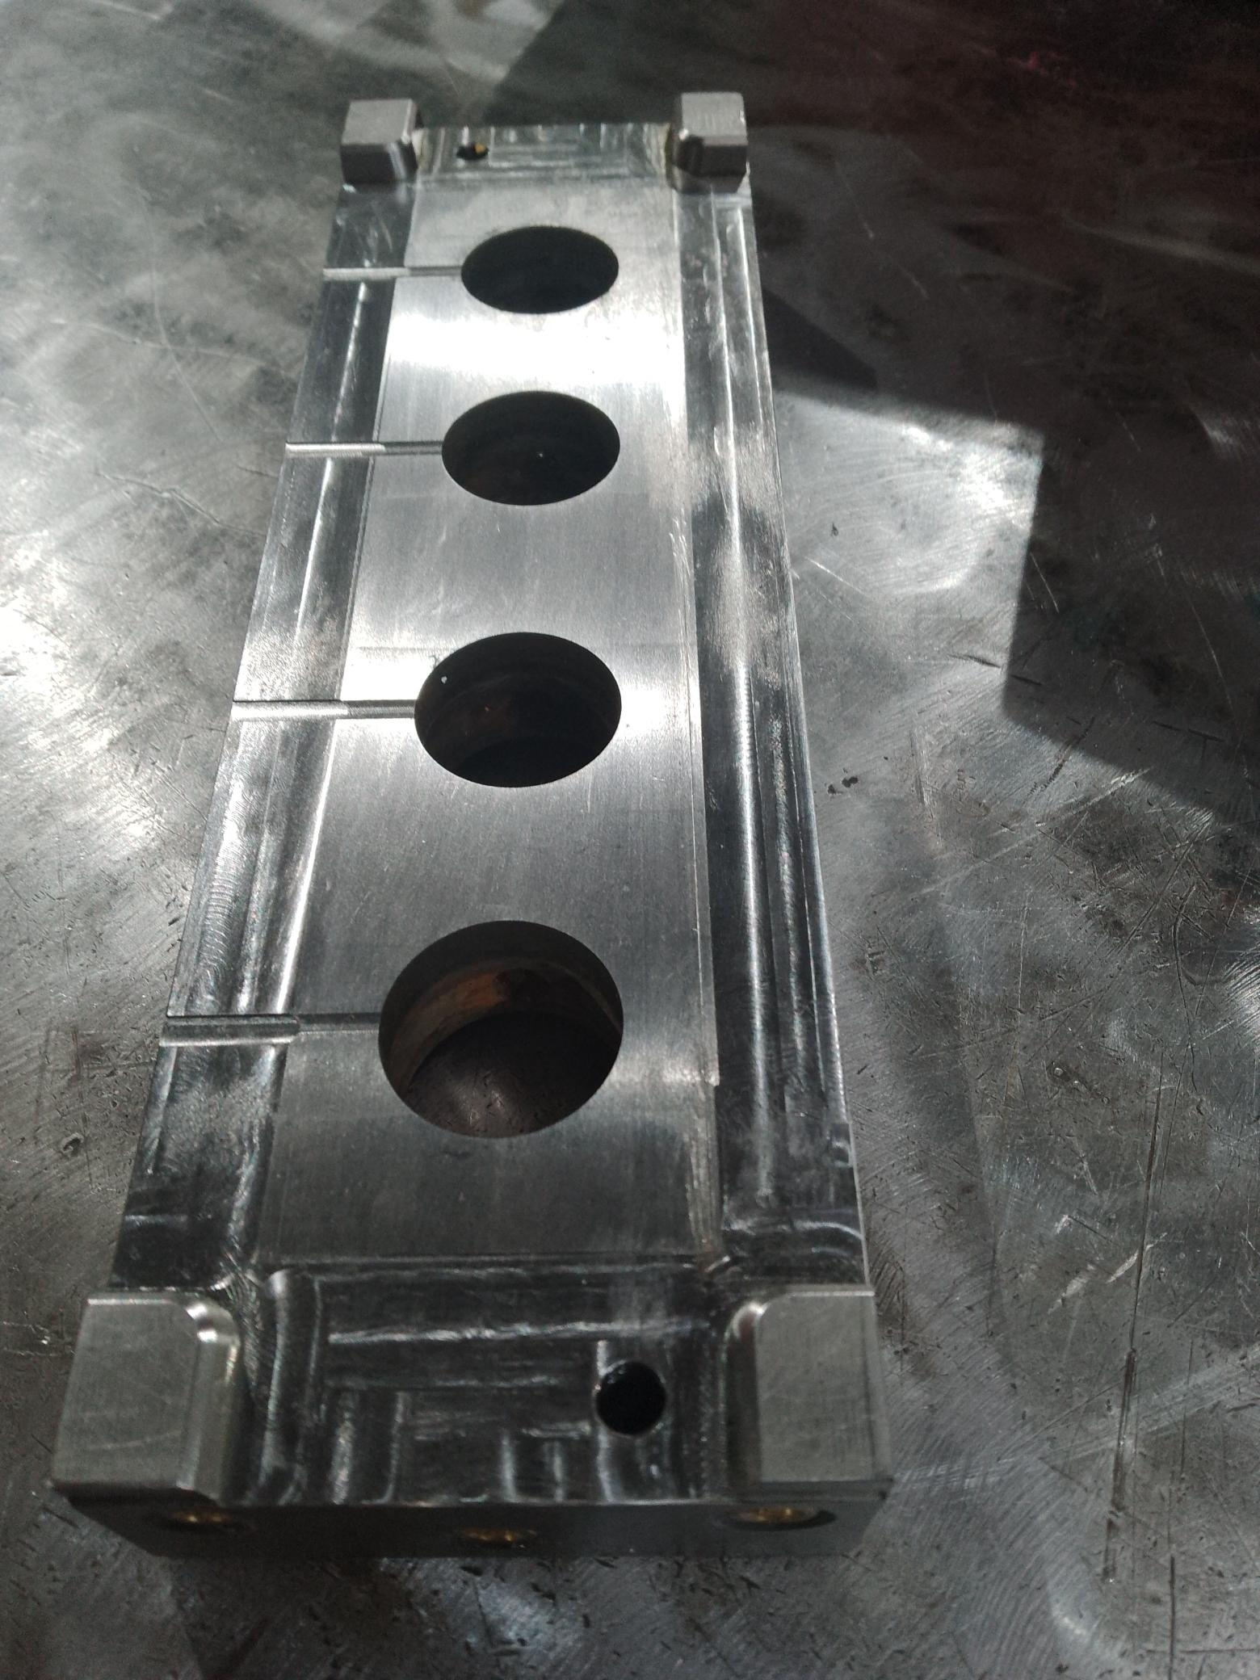
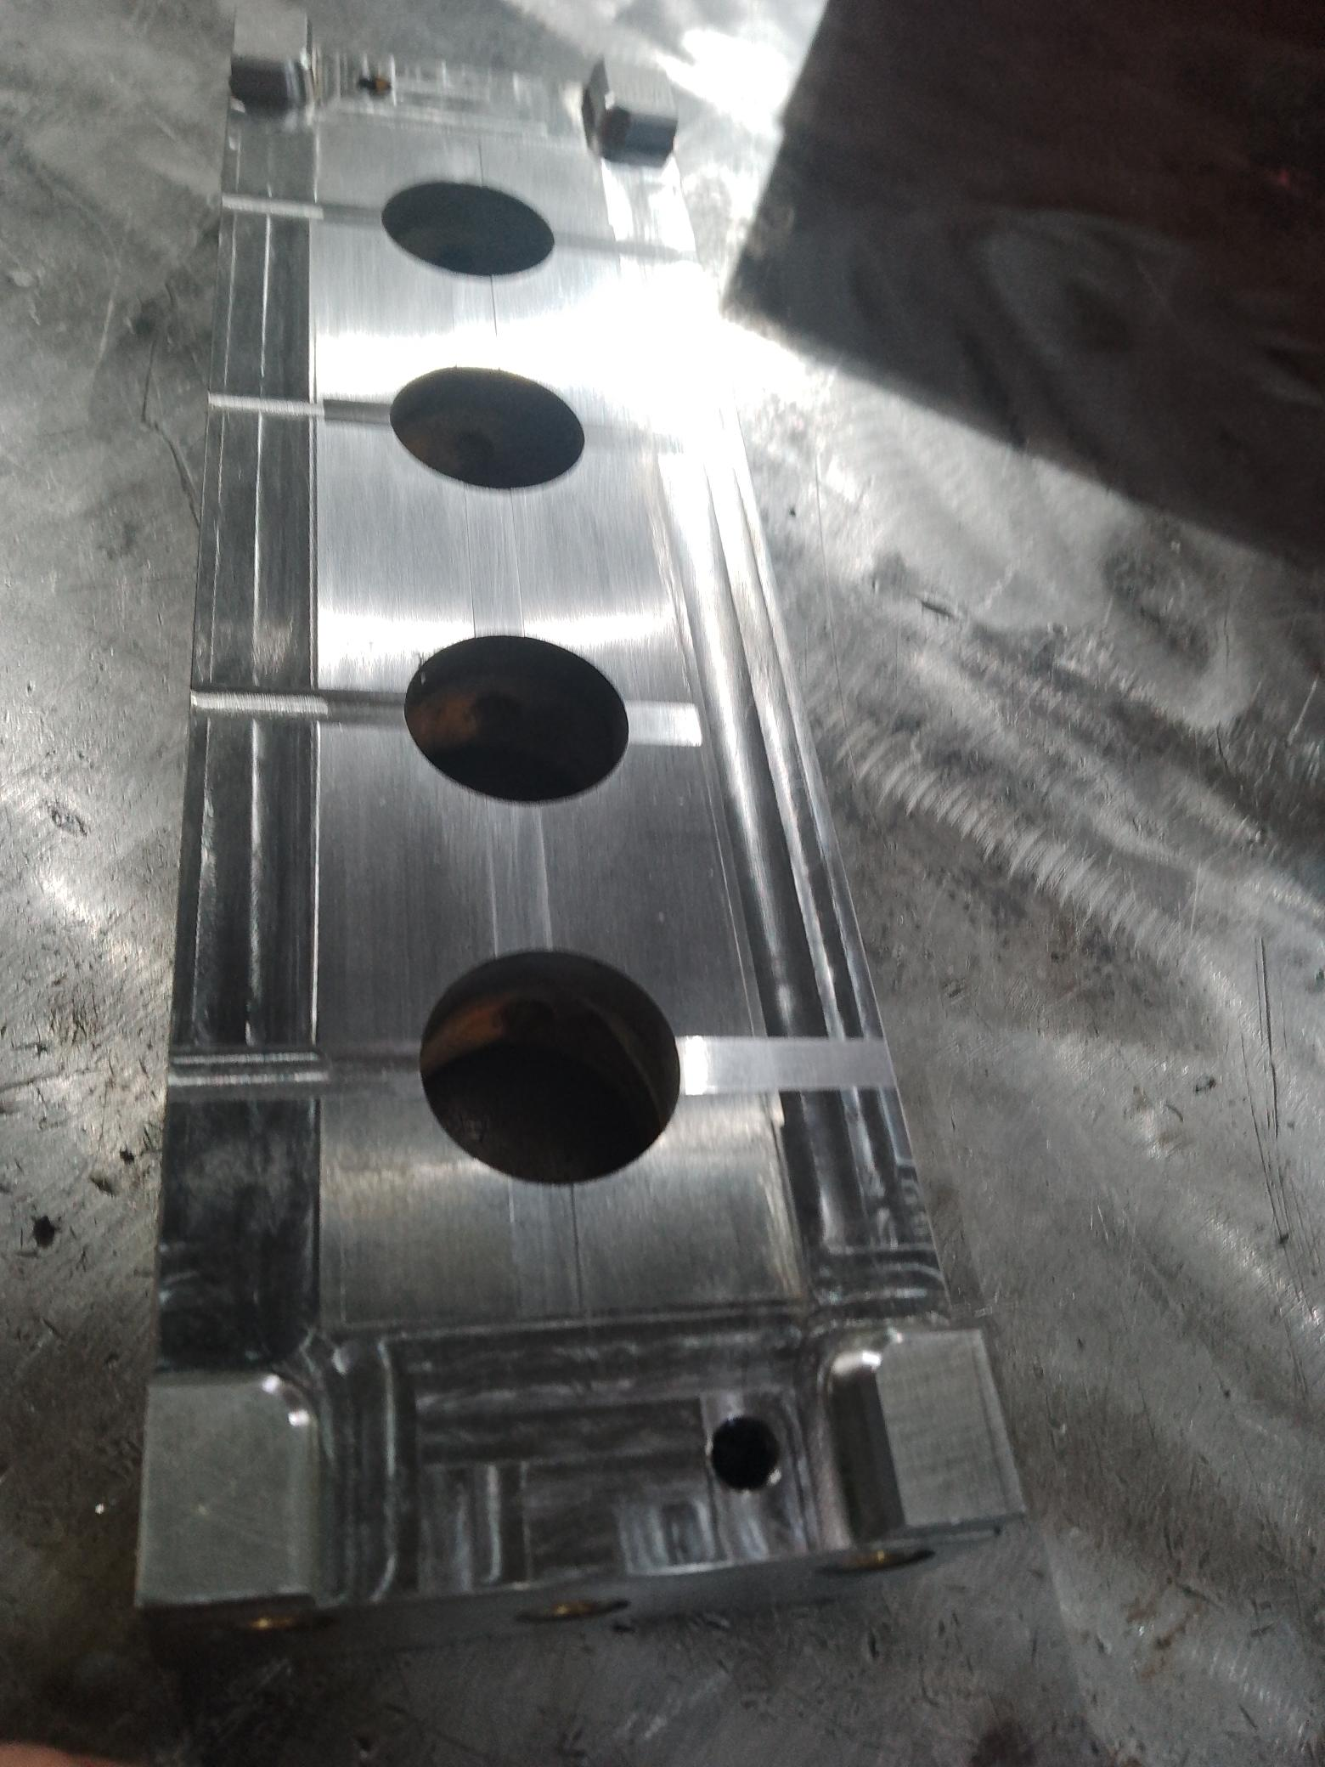
Molde H-BMQ 8095 P/N 43049F012
ONLY ONE VENT FOR CAVITY
TWO VENTS WERE ADED FOR CAVITY

Slide 3
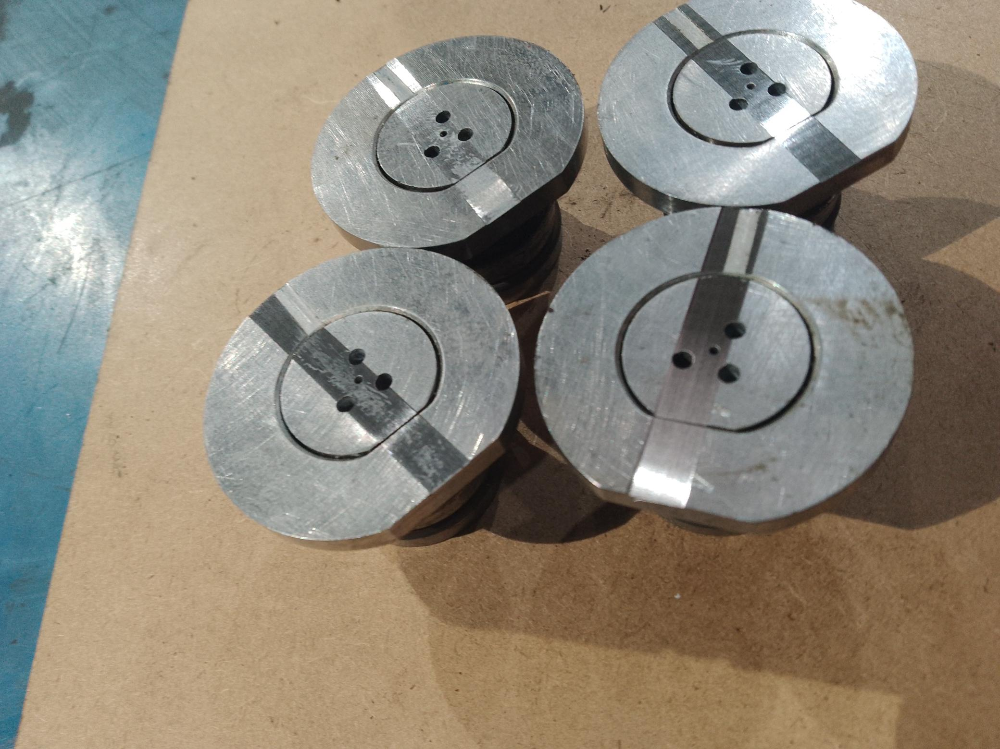
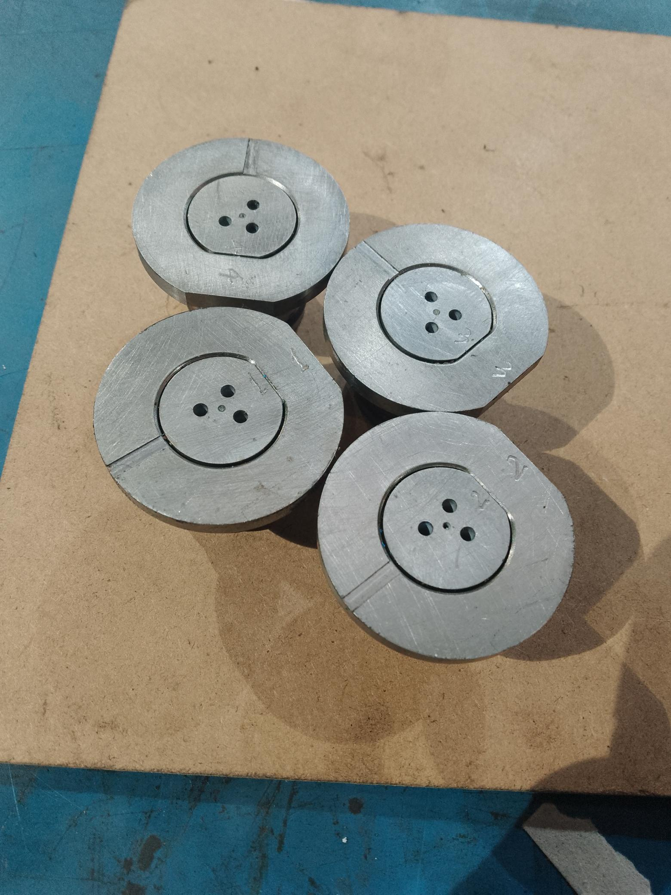
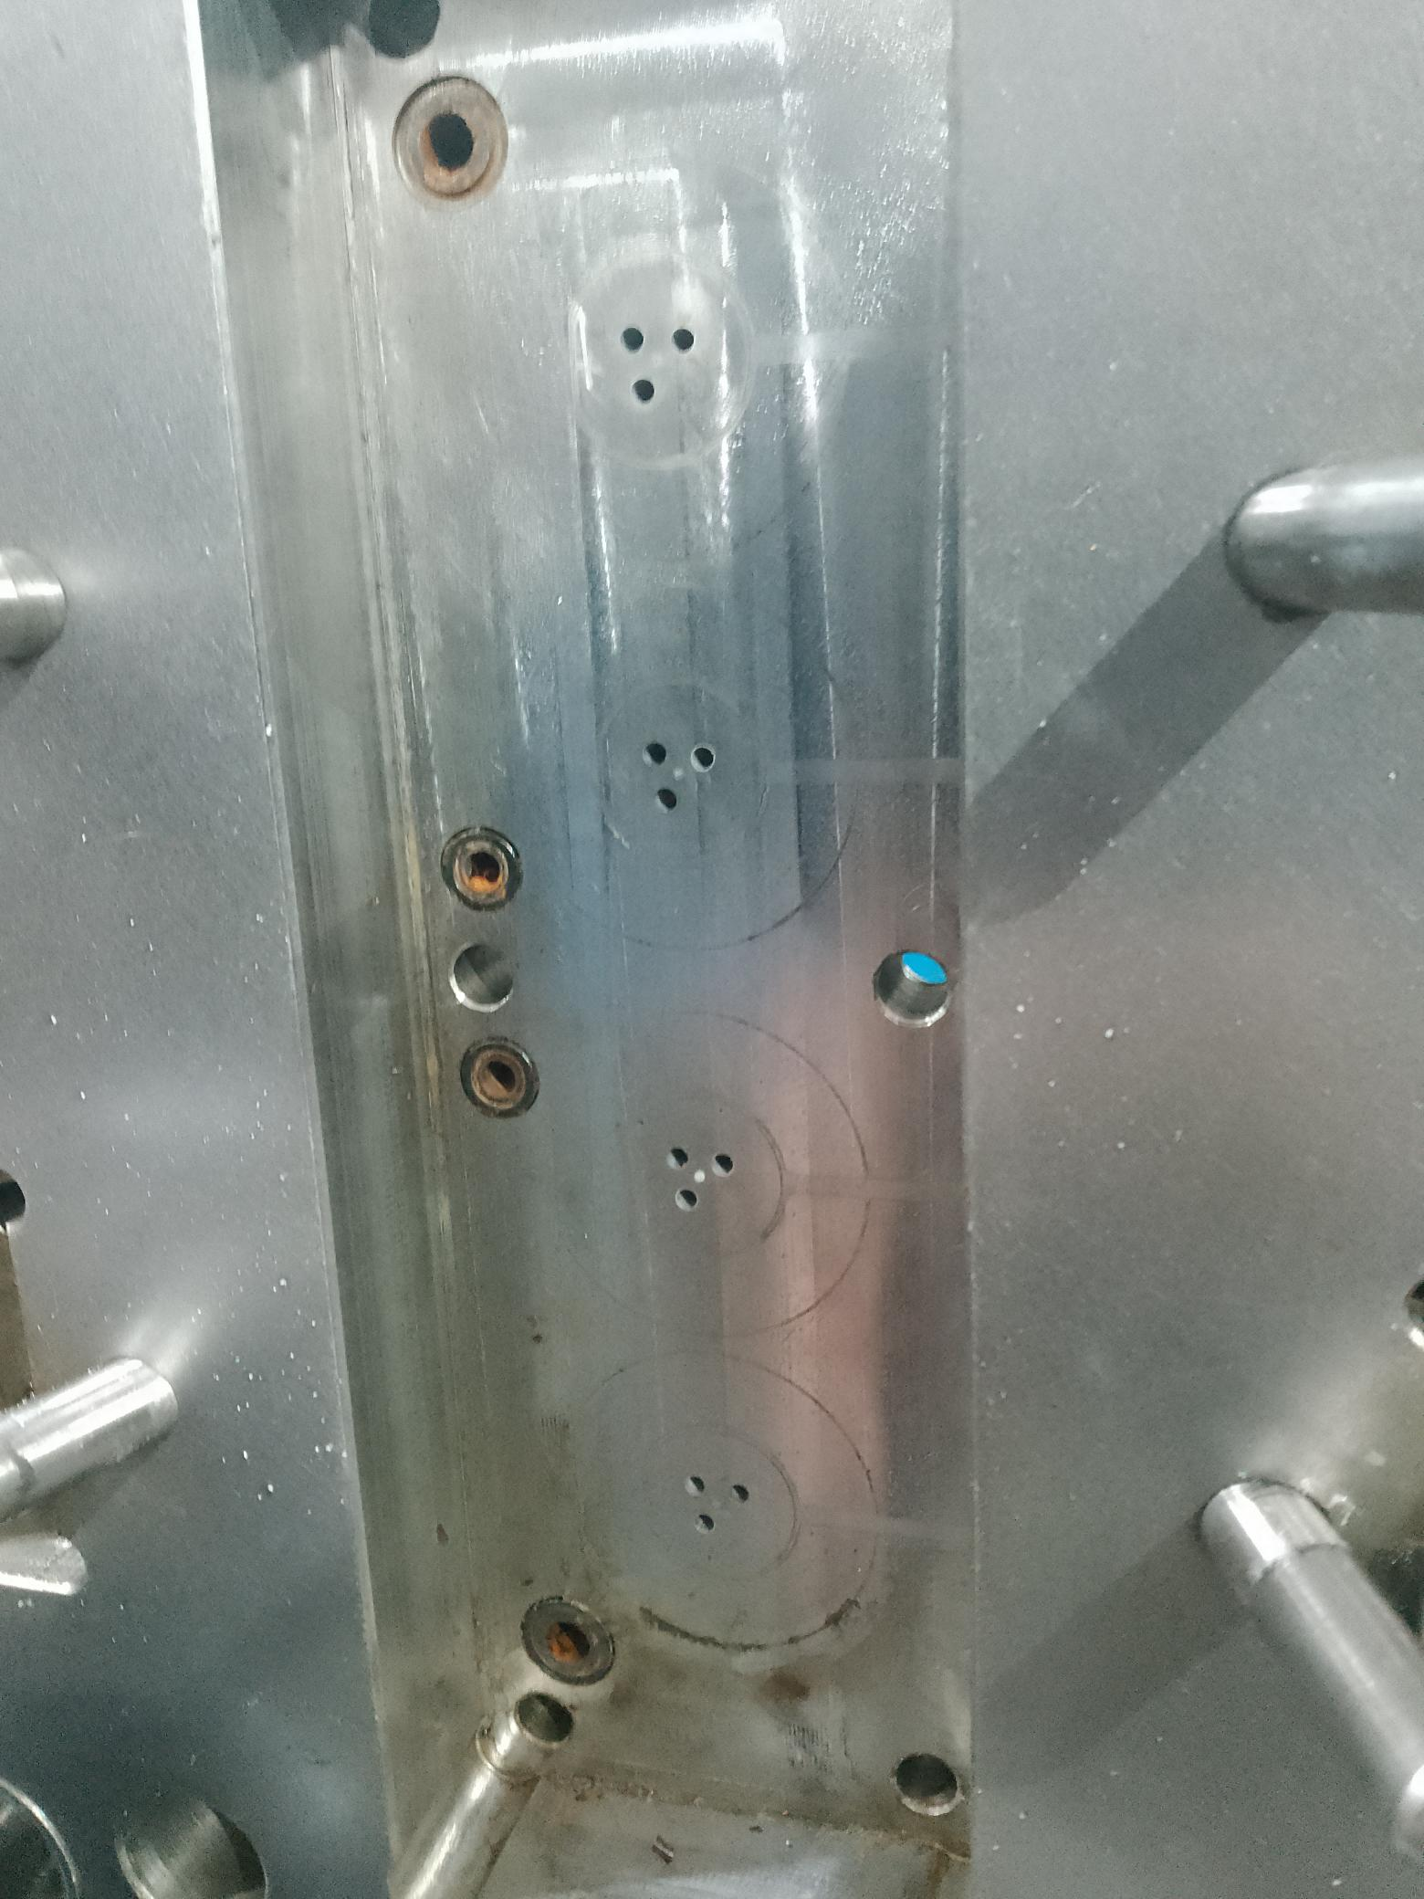
Molde H-BMQ 8095 P/N 43049F012
THREE HOLES VENTS BUT DOES NOT HAVE EXAUST
NO VENTS AT ATMOSPHERE IN THE SEAT PLATE
VENTS WERE ADDED WITH ATMOSPHERE EXAUST

Slide 4
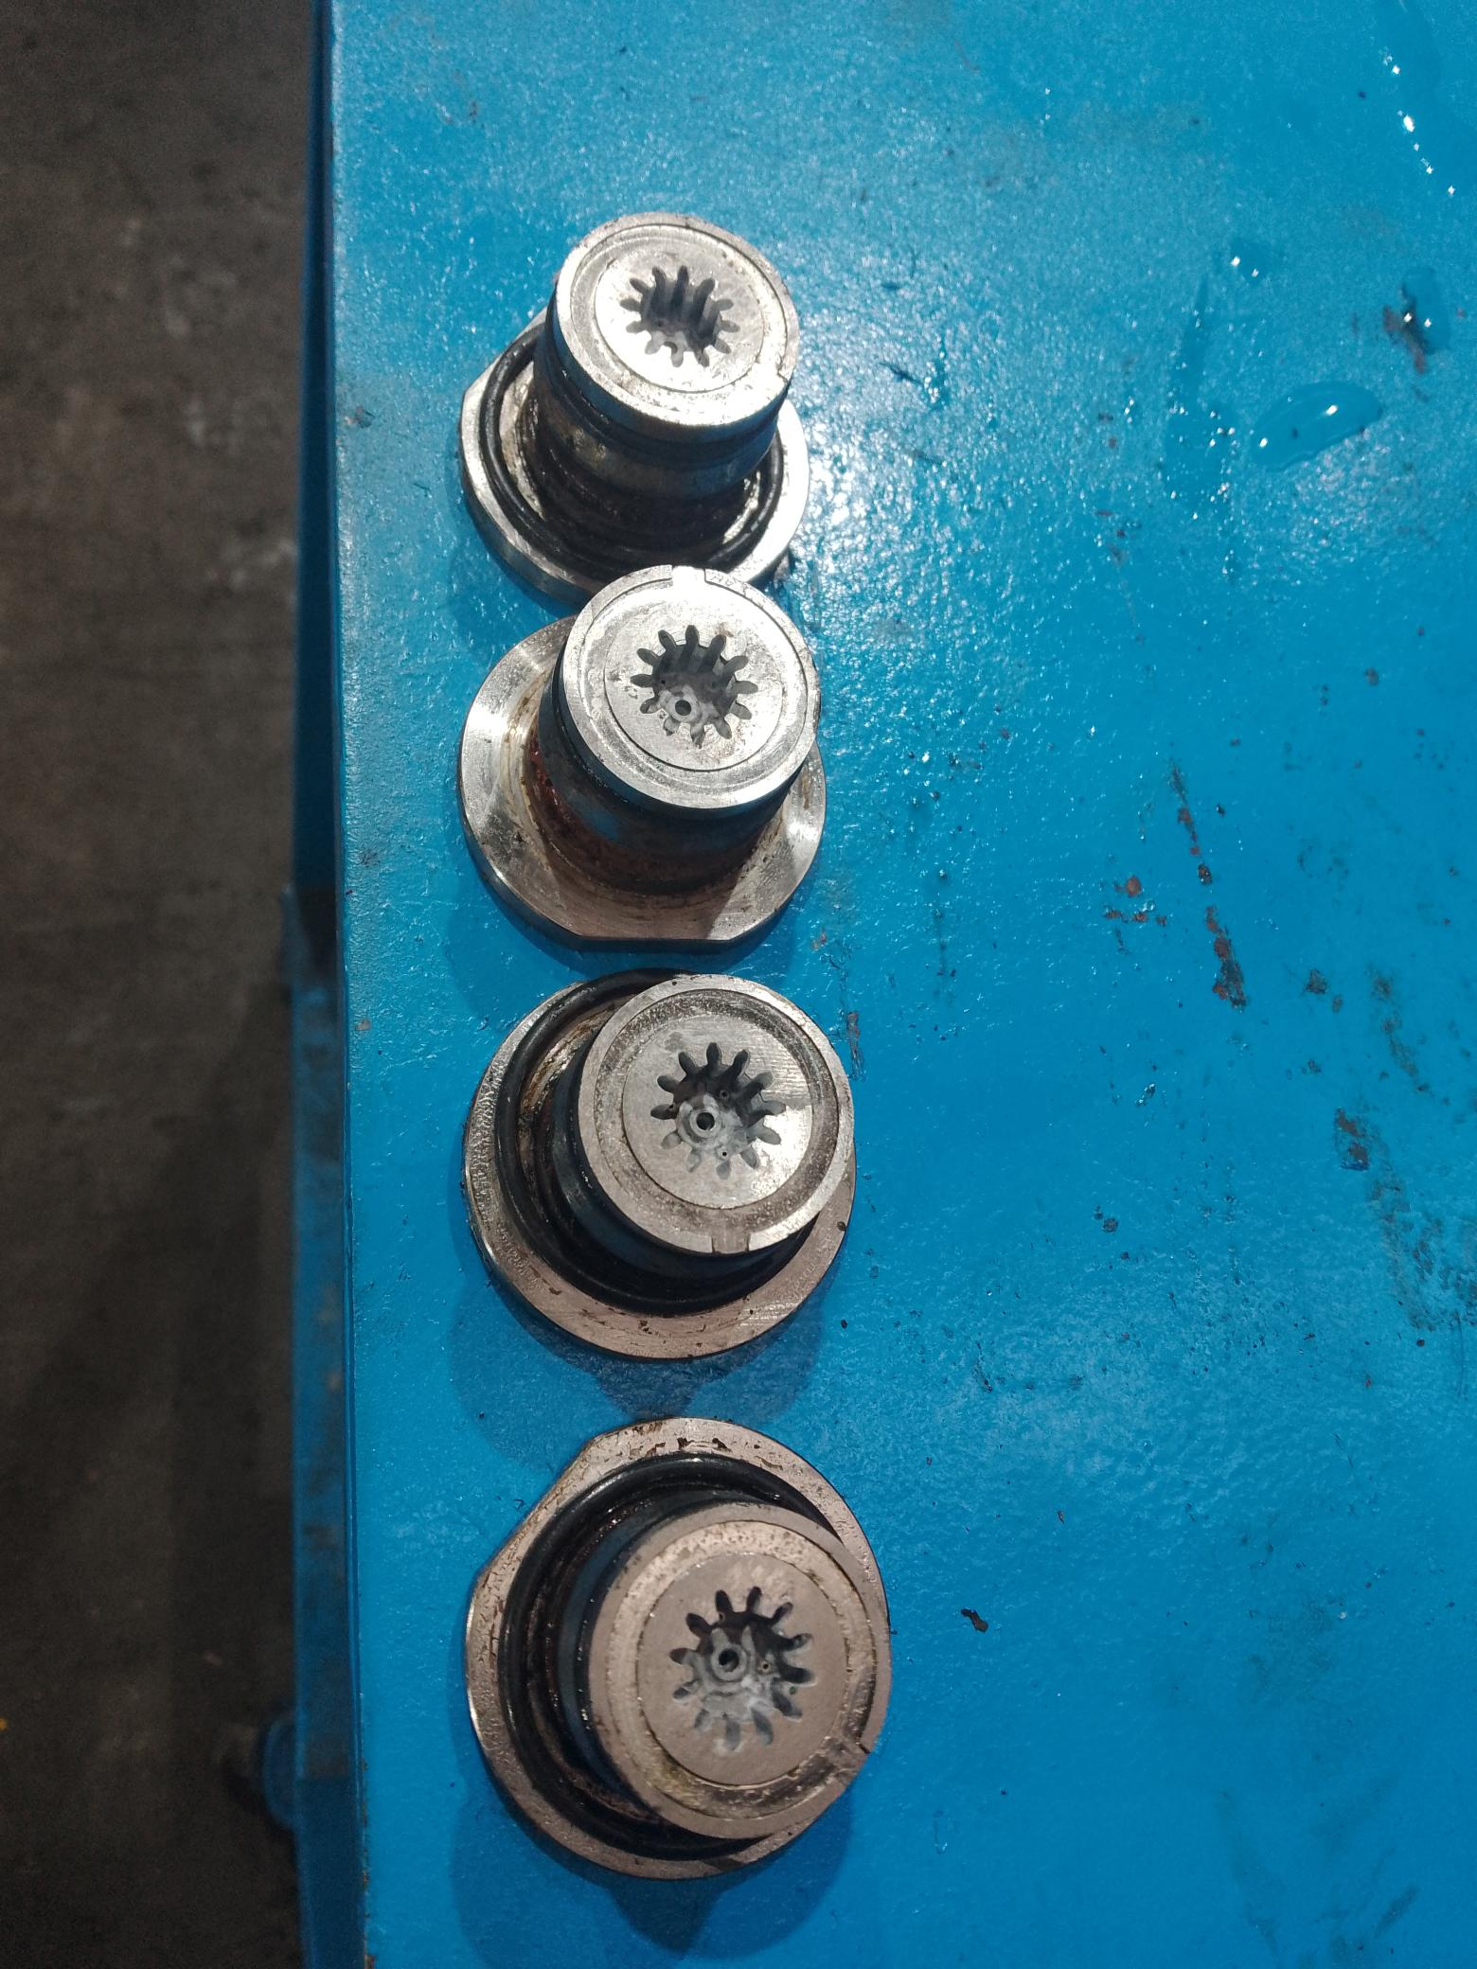
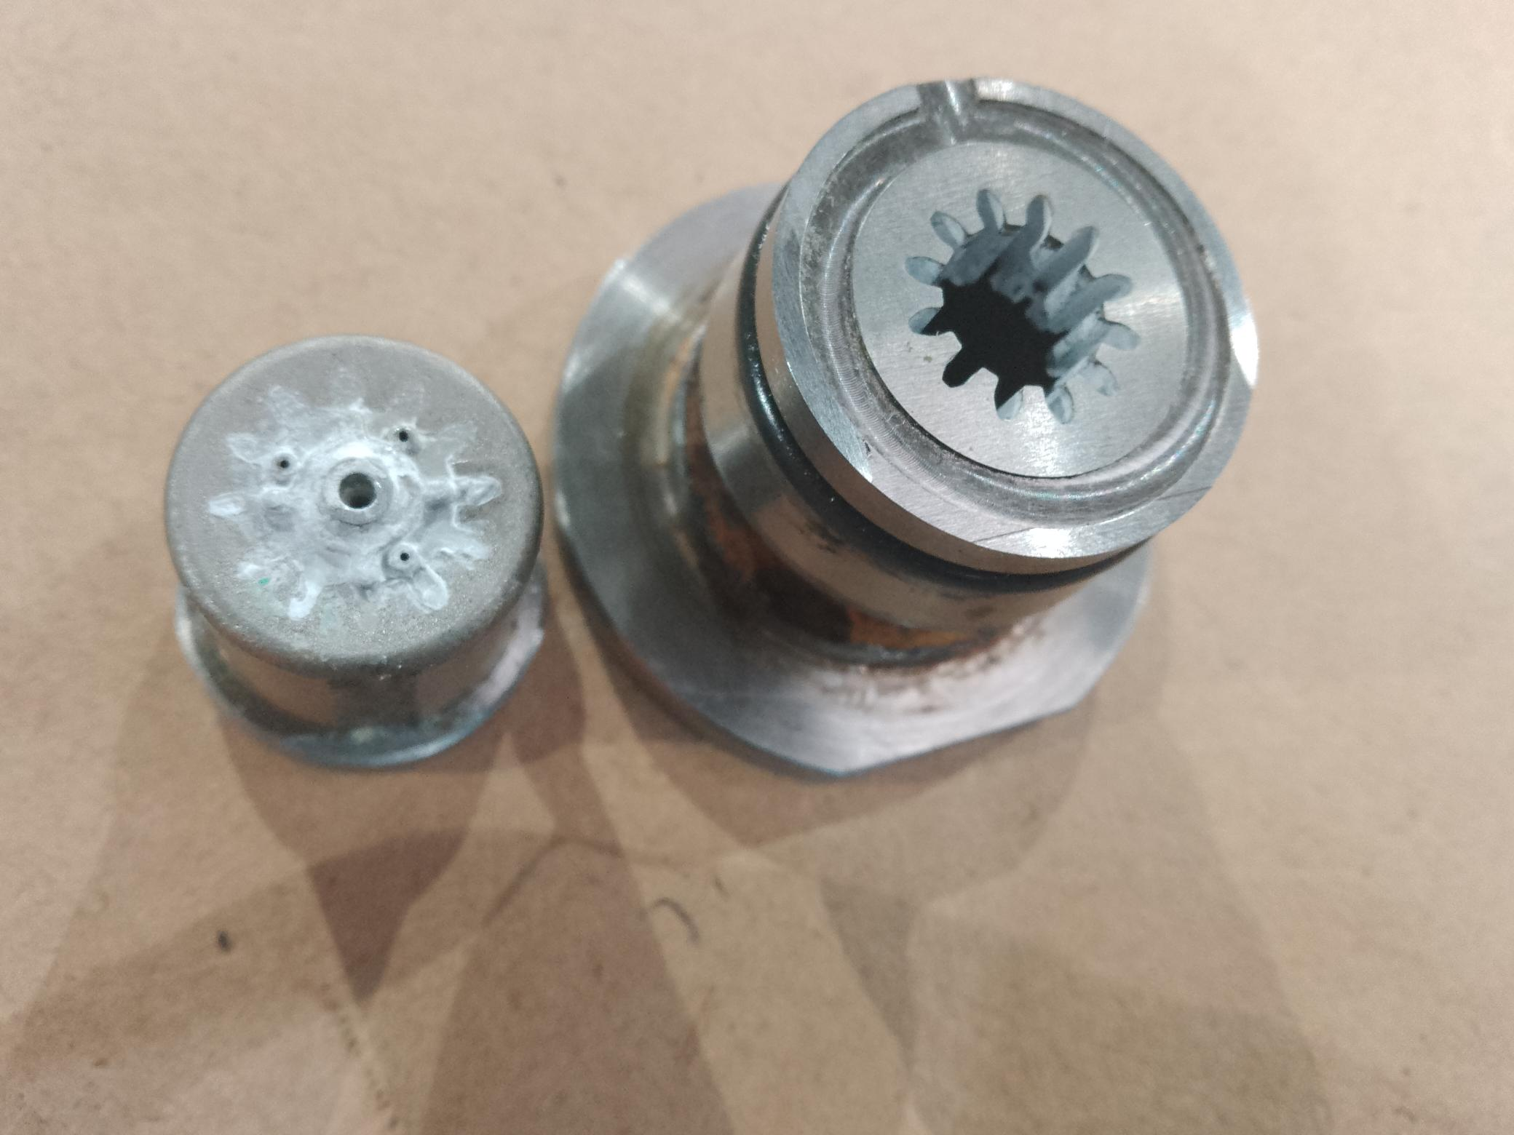
Molde H-BMQ 8095 P/N 43049F012
3 VENTS WERE ADDED IN EACH CAVITY
ONLY ONE VENT FOR CAVITY

