Slide 1
Operator’s self first article inspection / release

Slide 2
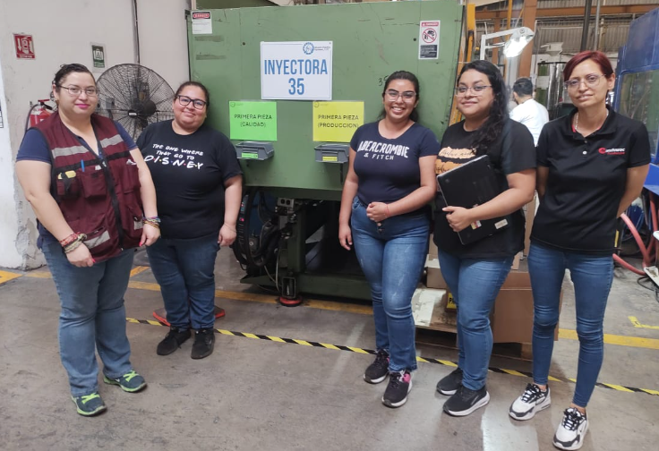
Kaizen Team

Slide 3
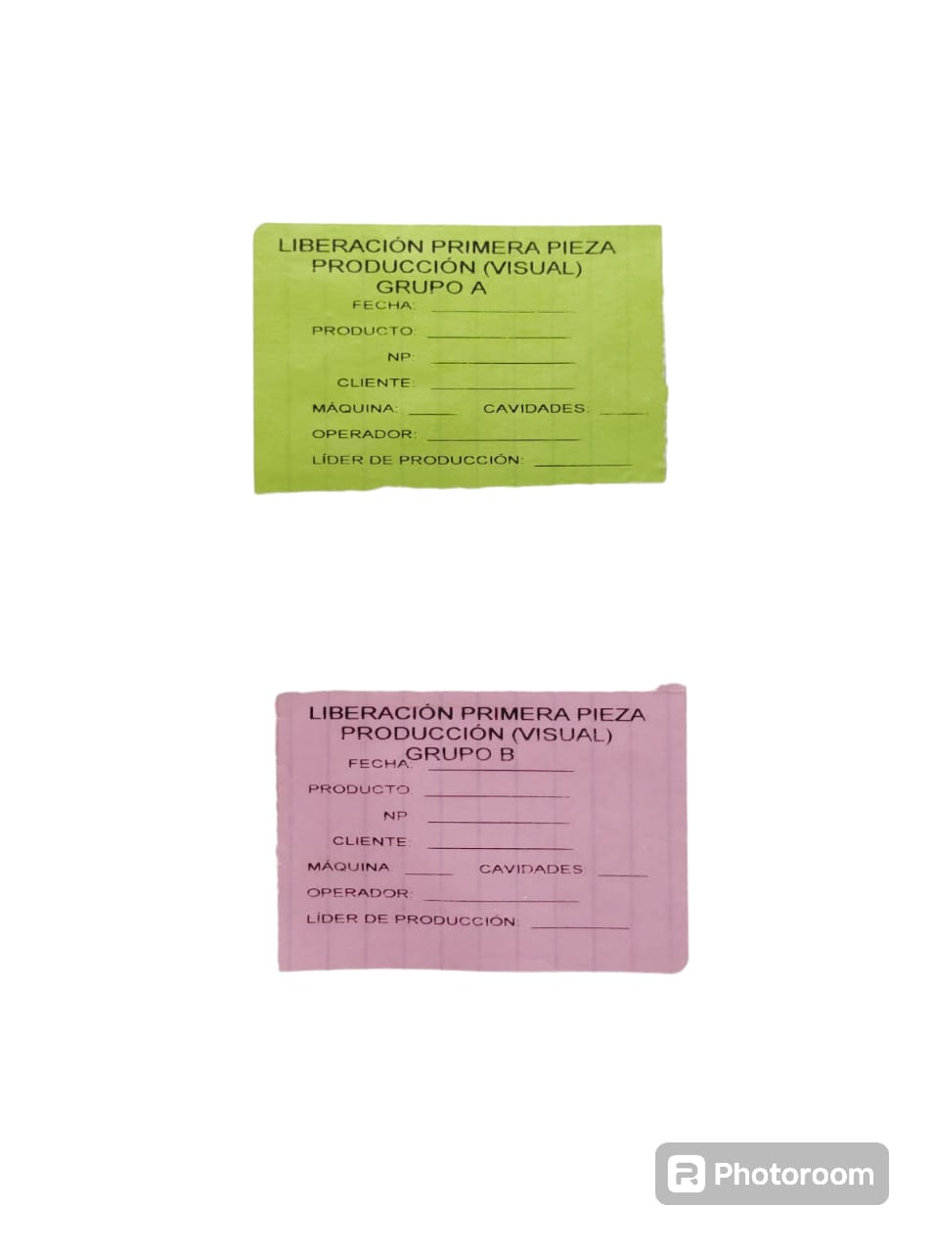
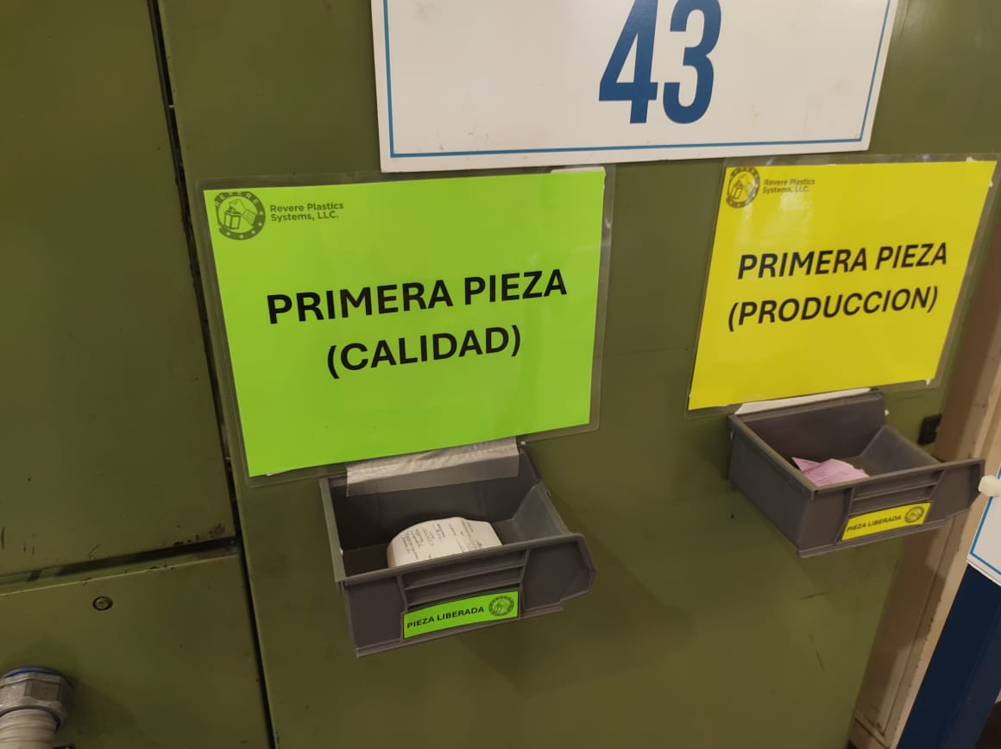
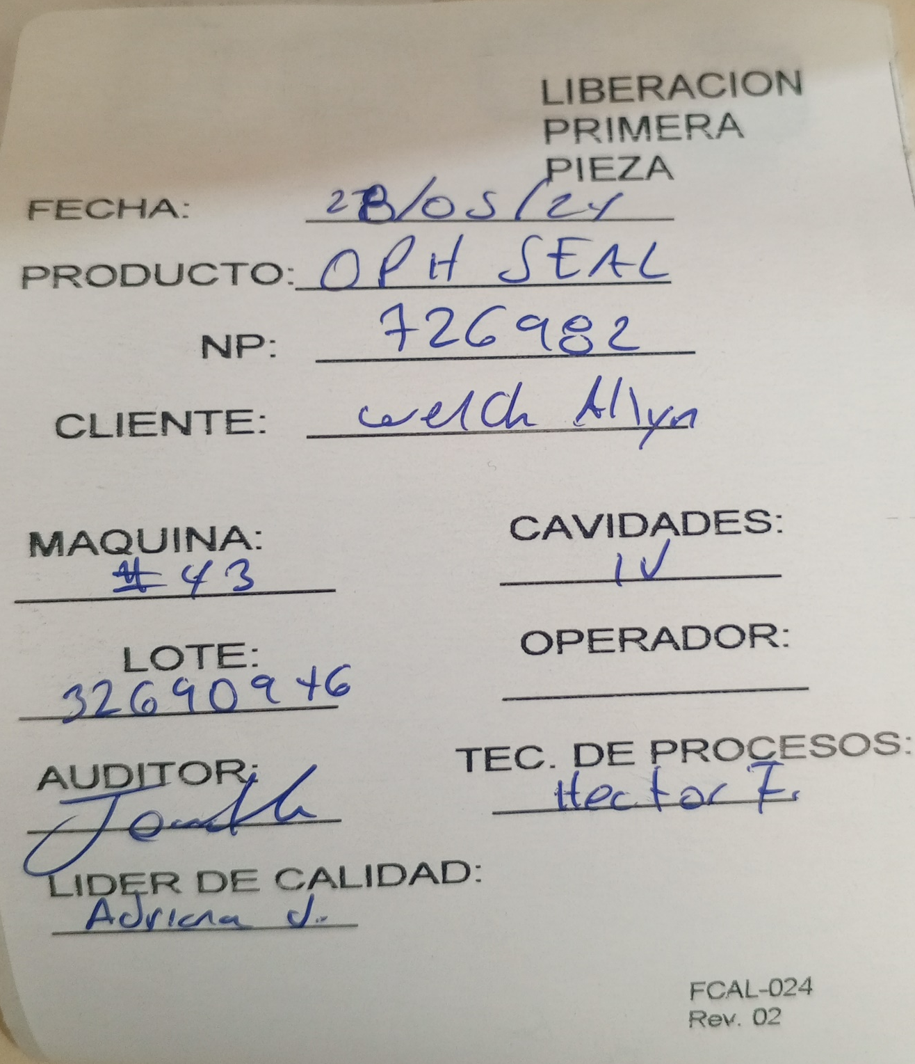
First Article Inspection Labels
Quality was the only function doing FAI Release.
New process implemented: operator’s self first article inspection / release for appearance items.
Downtime due to operation waiting for quality auditor.
Quality and Production FAI bins.
Production FAI Labels.
Quality FAI Label.

Slide 4
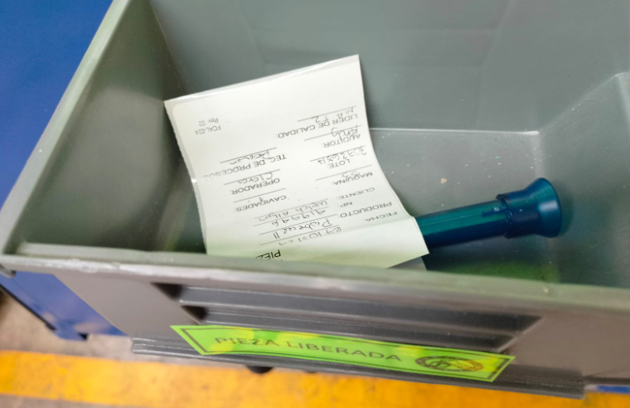
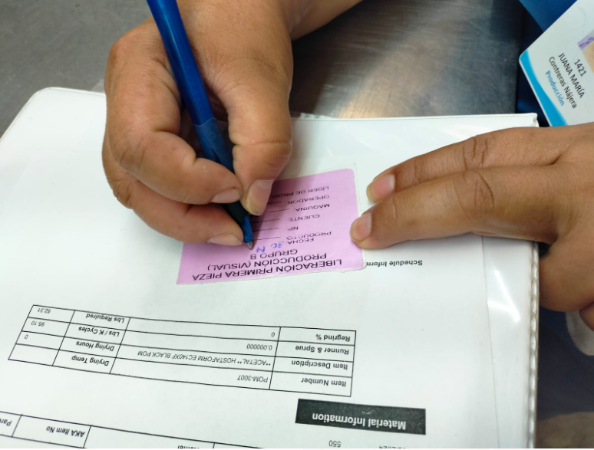
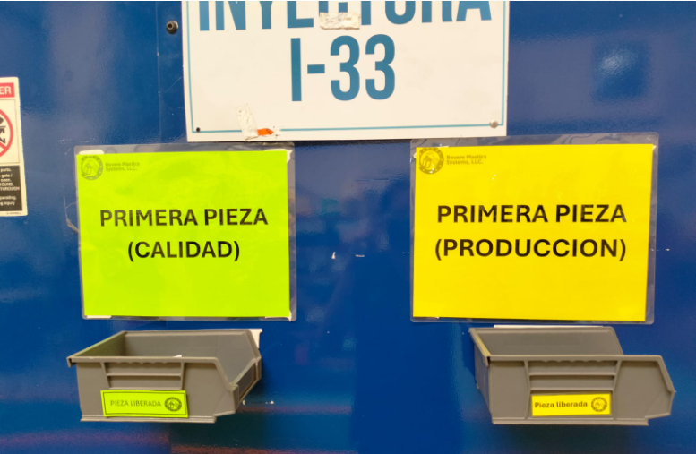
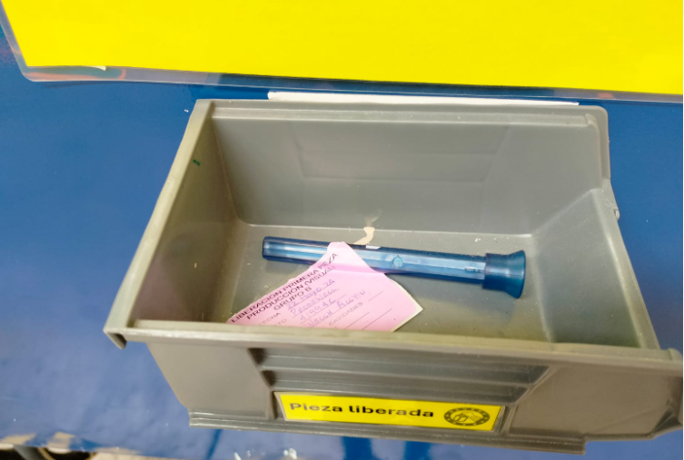
Operator’s self first article inspection / release process
Quality FAI bin.
Production FAI bin.
Opertator inspects appearance items and release the part
Opertator places the acceptance label and puts the part in the correspondent bin.

